Slide 1
Childhood Obesity
Caroline Rowley
Paediatric Dietitian

Slide 2
Aim and objectives
Aim:
Identify the obese child, the influences that contribute to obesity and the interventions to help achieve and maintain a healthy weight
Objectives:
Understand the causes and effects of obesity
Interpreting measurements
Overview of the energy balance, nutritional requirements and influences
Overview of government initiatives
How health professionals can help and support

Slide 3
What is obesity and what are the statistics?
World Health Organisation (WHO) has defined obesity as abnormal or excessive fat accumulation that presents a risk to health (WHO).
It may be classed as overweight or obesity depending on measurements.
Caused by an imbalance of energy in (food) and energy out (activity)
The National Child Measurement Programme (NCMP)
All children Overweight or obese Obese
Reception 22.6% 9.7% 2018/19
Year 6 34.3% 20.2%
Reception 22.6% 9.4% 2010/11
Year 6 33.4% 19%
Areas of deprivation the worse affected
Notes:
Calories above that required for a healthy weight
No studies so far have shown why deprived areas the worse affected – many variables to adjust for

Slide 4
Why is it a problem?
Emotional / behavioural / bullying / low self-esteem
School absence
High cholesterol / BP / pre-diabetes / bone & joint / breathing difficulties
Increased risk of becoming overweight adults
Risk of ill-health and premature mortality in adult life
(Public Health England - Guidance on Childhood obesity: applying All Or Health – May 2020)
Obese children with asthma associated with a greater airflow obstruction and a mildly diminished response to inhaled corticosteroids
(Jason E. Lang. Obesity, Nutrition and Asthma in Children. Paediatric Allergy Immunology and Pulmonology. 2012 Jun; 252): 64-75).
Notes:
Article of a review of more than 15 longitudinal cohort studies in adults and children.
Almost all obese participants found to be at higher risk of developing true asthma confirmed by specialist diagnosis
Up to date of the paper (2012) no evidence that asthma causes obesity but ample evidence obesity is a risk factor for asthma
possible interactions between smooth muscle dysfunction and oxidative stress compounded by exercise / genetic / diet factors)

Slide 5
Interpreting measurements
RCPCH growth charts
BMI better indicator of overweight (can be used from age 2 years)
Calculate BMI if weight alone is ≥75th C or weight and height C’s differ
Note: Weight alone >99.6th C almost always heavy
BMI ≥91st C – suggests overweight
BMI ≥ 98th C – obese
Calculate BMI by dividing weight (in KG) by square of height (in Metres)
Caution as BMI not specific for fat and changes as children grow
Depending on level of obesity and age of child aim for them to ‘grow into their weight’
Notes:
RCPCH – royal college of paediatrics and child health
Only use over 2 years of age

Slide 6
Energy balance
Calories in:
Boys and girls have different estimated calorie requirement for age e.g.
(Kcal)
Age (years) Boys Girls
1-3 1230 1165
4-6 1715 1545
7-10 1970 1740
11-14 2220 1845
15-18 2755 2110
Calories out:
Energy (kcal) used in physical activity (per hour)
Video games 22-32 Bike riding 118-172
Skate boarding 74-108 Ballet 71-103

Slide 7
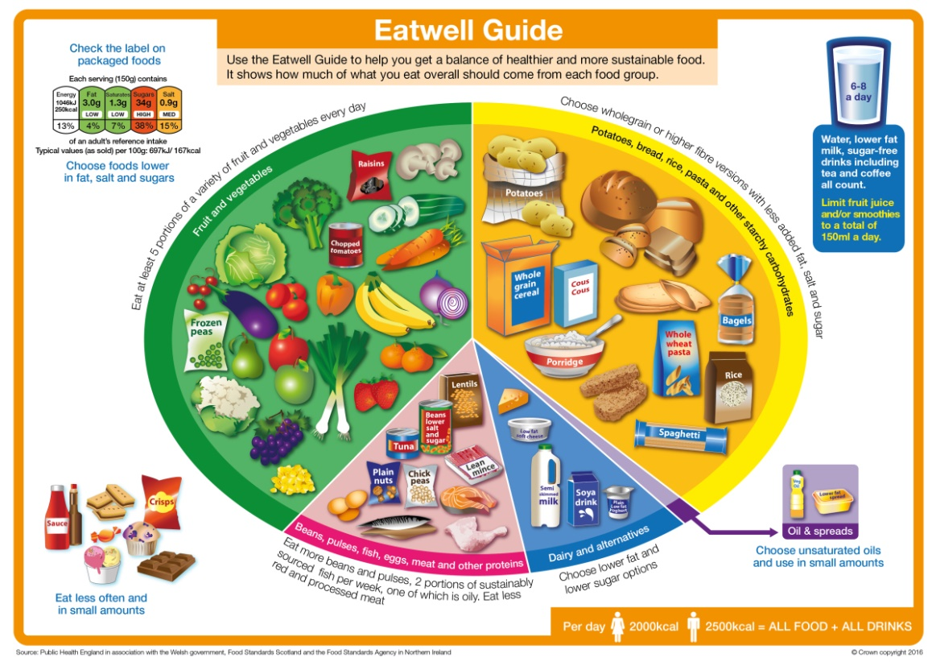
The Eatwell Guide
A pictorial summary of the main food groups and their recommended portions for a healthy diet
Notes:
Current dietary recommendations

Slide 8
Activity
Regular physical activity:
Helps develop movement skills
Assists the Energy Balance and uses calories up to help maintain a healthy weight
Cardiovascular benefits and strengthening bones
NHS website:
Physical activity guidelines for children (under 5 years)
Physical activity guidelines for children and young people (aged 5-18)
Sedentary activities:
Useful:
arts and crafts, reading
Not useful:
A child kept in a push chair when they could be walking, screen time etc.

Slide 9
Factors that influence obesity
A complex interaction of biological, environmental and social factors influences the likelihood of a child gaining excess weight e.g.
Diet
Activity levels / exercise / hobbies
sleep
screen time
Mental health
Ethnic and cultural influences
Socio-economic status
Maternal obesity
Family dynamics
Genetic differences in appetite and metabolism
Education (Home economics, GCSE food technology)
(Food in the school curriculum in England: Its development from cookery to cookery Gwyneth Owen-Jackson, The Open University Marion Rutland, University of Roehampton)
Notes:
RCPCH - higher screen time less healthy diet, higher energy intake – to negotiate screen time
Home economics (life skill), food and Nutrition, GCSE Food technology (food production)
Political influences have affected teaching of food and nutrition / life skill in schools

Slide 10
How we used to eat!
Mrs Beeton’s everyday cookery (1963)
Family food
Variety
At least one helping of protein at breakfast, midday, evening meal
Children and expectant mothers - one pint of milk daily
Enough fats, starches and sugars to satisfy appetite and allow normal growth in children / maintain body weight of adults
One helping of potatoes and at least one serving of fresh vegetables, or salad or fruit to ensure an adequate amount of Vitamin C
Snacks: ‘redundant food is obtained by those who find themselves more than adequately nourished’ and should be ‘watched carefully as the main meals by those who guard the family health’

Slide 11
Life today!
Processed high sugar, high fat food and drinks
Lots of variety – more variety means increased food consumption
Lots of new food products e.g. plant-based foods, breakfast cereals
Snacks
Takeaway food and delivery meals (fast food)
Ready meals
Confectionary – ‘family’ sizes often more economical
Crisps – 90p per pack £1 for 6 packs
Abundance of food
Effects of advertising
More food outlets / restaurants / cafés
Working parents / carers
Family time constraints
More sedentary lifestyle

Slide 12


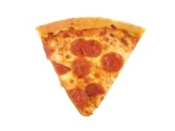

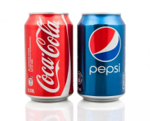

Calorie content of common foods
Fruit Juice 1 litre carton – 460 kcal
Packet of crisps 184kcal
Pizza (1 slice) average 250 kcal
McDonald’s medium fries 312 kcal
Cola (355ml) 149 Kcal
Milk chocolate buttons (119g) 636 Kcal

Slide 13
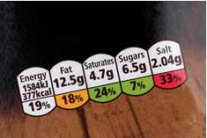
Nutrition labelling
Provides information to make an informed choice when deciding what food and drink products to buy (Food Standards Agency)
Notes:
Mandatory for nutrition information to be displayed on the back some food manufacturers / supermarkets display nutritional information on the front.
Compares calories / fat / sugar / salt

Slide 14
Government strategies
Soft drink industry levy
Sugar tax – 20% less by 2020 – ingredients or product size.
Funding to science and technology for development of healthier products
School Food Standards / Early years settings
Food labelling
Change4Life – Sugar Smart app
Health professional – resources to support confidence discussing nutrition and weight issues – All Our Health: Childhood Obesity https://portal.e-lfh.org.uk/Component/Details/587409
National Child Measurement Programme (NCMP)
Children and young people at least 60 mins mod-vigorous activity per day
Investment in sports and physical activity programmes – in schools, outside of school and walking and cycling to school (Bikeability cycle training for children)
September 2017 – introduction of voluntary health rating scheme for schools (Ofsted)
HENRY
Notes:
Childhood obesity: a plan for action 2017
Sugar tax – led and run by PHE for all sectors of industry – breakfast cereals, yoghurts, biscuits, cakes, confectionary, puddings etc
Some academies and free schools not subject to School food standards
Sugar Smart app – help families weekly shop on fat, sugar and salt
Health professionals – resources on behaviour change. Health Education England Aug 2019
Healthy Eating and Nutrition in the Really Young – whole family approach to achieving and maintaining a healthy weight from pregnancy to the end of primary school

Slide 15
What research tells us…..
Family based lifestyle interventions are the most effective:
Niemeier B.S et al. Parent participation in weight-related health interventions for children and adolescents: A systematic review and meta-analysis. Preventative Medicine; volume 55, Issue 1, July 2012
Interventions consisted of nutrition education, physical activity education / sessions, behaviour education / therapy
The study suggested that parent participation more effectively reduced BMI in child and adolescent participants and the longer they are involved the more effective.
Notes:
Objective
To review child and adolescent weight-related health intervention characteristics, with a particular focus on levels of parental participation, and examine differences in intervention effectiveness.

Slide 16
Actions to help
Raise the issue!
Provide consistent evidence based advice
Health professional – resources to support confidence discussing nutrition and weight issues – All Our Health: Childhood Obesity https://portal.e-lfh.org.uk/Component/Details/587409
Look at local Trust obesity guidelines – signposts where to refer / co-moribidities and complex features
Paediatric dietitian
Specialist childhood obesity services e.g. HENRY
Initial advice:
First step – regular meals
What are the barriers (family, parenting issues, child always hungry etc..)
Check diet – include food and drinks (e.g. portion sizes, snacks, meal frequency, drinks)
Lifestyle – hobbies, activities, screen time, sleep etc.
Psychological support
Signpost to locally available activities – see local council website
Encourage walking, using stairs instead of lifts, avoiding over use of push chairs etc.

Slide 17
Nutrition and Dietetics
Whittington Health
Magdala Avenue
London
N19 5NF
Tel: 020 7288 5851

