Slide 1
Back to School and Asthma – Taking a Whole School Asthma Approach
Heather Robinson – Transformation Lead, Children’s Health 0-19 Service, LBN
Emily Guilmant-Farry – Children’s Community Asthma Nurse Specialist, ELFT

Slide 2
Quick disclaimer!
As with everything related to COVID-19 the information available is ever changing,
Please review these slides with the latest Government guidance.
04/09/2020

Slide 3
Back to School
All children and young people (CYP) have now returned to school
Shielding was paused on the 1st August 2020
Very few CYP remain on the shielding list should the need to shield return if rates of the disease rises in local areas
If a CYP with asthma remains on the shielding list they will have been advised by their specialist
Latest evidence suggests that the risk of serious illness for most CYP is low
04/09/2020

Slide 4
COVID-19 and CYP with asthma
COVID-19 had the opposite effect to the one most of us expected, of a high incidence of infection due to asthma co-morbidity. In actual fact the UK (and overseas) saw a significant drop in emergency attendance for asthma March – August 2020.
The reasons are not yet evidenced, but are thought to be around:
Improved adherence to preventer medications – Newham had an increase of 138% in preventer prescriptions for CYP in March 2020 compared to the year previous.
No school attendance, so decreased physical activity, and reduced availability of respiratory illnesses, so many common triggers were reduced.
Air pollution dropped significantly over lockdown, although sadly, rates are nearly back to pre-lockdown levels now.
Importantly, the risk of COVID-19 infection and illness is low compared to the risk of not treating asthma.
There is a greater risk of a fatal asthma attack if they do not seek help because of a fear of COVID-19
04/09/2020

Slide 5
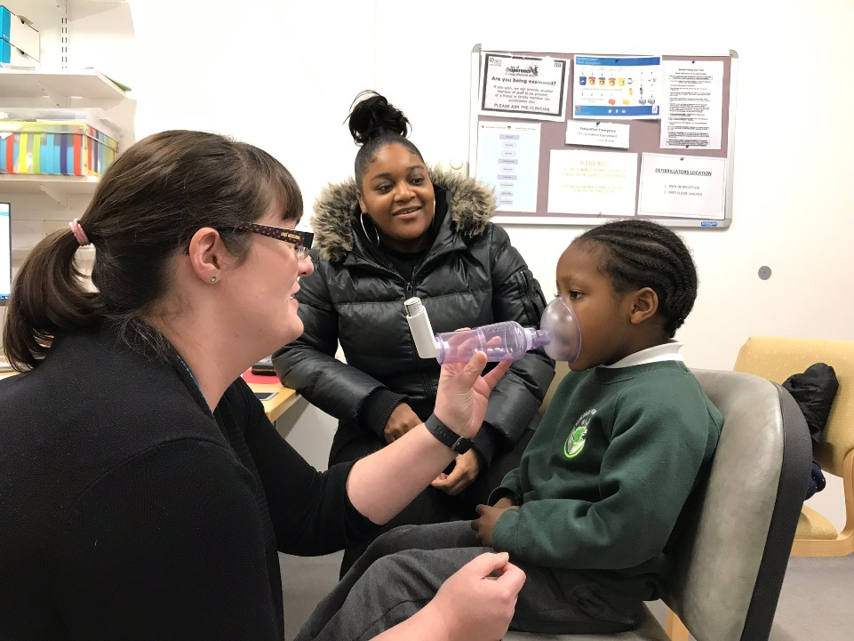
Asthma care in schools
Business as usual
Every CYP at school with asthma should have:
A Personalised Asthma Action Plan (PAAP)*
A reliever inhaler
The correct spacer
Every school should have as an absolute minimum:
An asthma policy
An asthma register
Trained staff and asthma leads
Emergency kit and consent to use
04/09/2020

Slide 6
Why does the risk of asthma attacks increase when returning to school?
And what impact could COVID-19 have?
Triggers | Cons | Pros
Seasonal colds | Spending more time indoors Spent up to 6 months apart | Better hand and respiratory hygiene Cleaner environment Wearing FC/masks Social distancing Self and household isolating
Dust mite and seasonal allergies | Increased exposure as more time spent indoors | Cleaner environment Wearing FC/masks
Preventer inhaler routines disrupted | Spent up to 6 months out of normal school routines | Improved concordance
Anxiety and stress | Increased time spent away from school COVID-19 concerns
04/09/2020

Slide 7
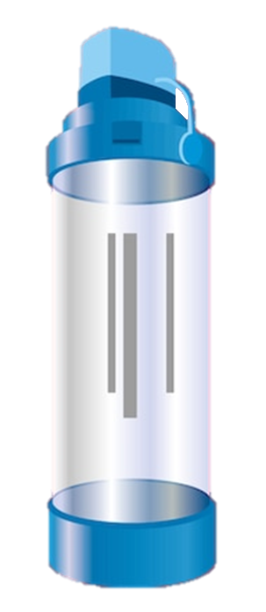
Spacers
Where possible maintain a social distance when supporting a CYP using a spacer
Adult to stand behind and to the side of the CYP, CYP breathing away from the adult but adult is able to observe valve moving back and forth and listen for whistle.
Ensure room is well ventilated, large enough space, open windows
No sharing
Storage
Not in a plastic bag, cotton bag is ideal
Washing spacers
Half termly or if visually dirty
Ensure the spacer is returned to the right CYP after washing
Wash hands
04/09/2020

Slide 8
Face Coverings and Masks
Government guidance should be followed re. where, when and who
CYP with asthma (even severe) can wear FC/masks if they are comfortable to do so
If it makes breathing difficult it could be due to uncontrolled asthma – talk to parent/carers, refer to School Health/GP
Practice wearing for short periods of time and try different types
Benefits - barrier between triggers
Filters the air – mould spores, dust, pollen, pollution
Improves respiratory hygiene
Warms the air
Anecdotally parents and CYP are reporting an improvement in symptoms since wearing FC/mask
04/09/2020

Slide 9
Cleaning
“ While professional cleaners often report respiratory symptoms, such as cough, when they are at work we believe this is due to the process of applying the products (and particularly sprays). The symptoms are thought to be due to irritation.
There is no evidence to suggest a newly cleaned room (even where ‘strong’ chemicals have been used) will have sufficiently high levels of cleaning agents lingering in the air to trigger respiratory symptoms; but it’s probably good practice, all things being equal, to open the windows after cleaning. For those with well-controlled asthma, strong smells (including bleach) do not generally trigger asthma symptoms.
Conversely, the increase in frequency of cleaning in schools may result in a reduction in virus transmission between children – viral infections being a common cause of respiratory symptoms.”
Dr Johanna Feary MRCP (UK), PhD, MSc
Senior Clinical Fellow in Occupational and Environmental Medicine
National Heart & Lung Institute, Imperial College
04/09/2020

Slide 10
Whole School Asthma Approach
A new approach to asthma care in Newham schools
Estimate there are 6000 CYP in LBN who have asthma
Sub-optimal housing (damp/mould), pollution (congested roads, industrial traffic)
Everyone with asthma should have a PAAP but we know these aren’t always completed in primary and secondary settings, they are completed but don’t make their way into school or they aren’t reviewed annually
Request for a PAAP or PAAP review accounted for 20% of all referrals to the School Health Service from schools in 2019/2020
School Nurses ‘mopping up’ for the wider system
In some schools, school staff writing PAAP
04/09/2020

Slide 11
Looking for a solution
LBN was already working towards all schools being ‘Asthma Friendly’
Already provide regular asthma management training for school staff but not achieving the reach of all school staff
Trying to shift the focus of School Health from completing PAAPs to supporting schools to become Asthma Friendly environments
Limited resource and capacity, stuck in firefighting mode ‘CYP still need PAAPs!’
PAAPs (or any IHCP) can take multiple appointments (e.g. was not brought, wrong medication/device), appointments take time to arrange, associated documentation, or if not completing the PAAP time is spent chasing from wider system
This is all when they should be and are better completed elsewhere in the system (GP, clinics, hospital)
04/09/2020

Slide 12
What have we done so far?
Both have membership at the Pan London CYP asthma nurse network meetings where we had the pleasure of hearing about the work taking place in Hillingdon schools in November 2019
We felt inspired to localise this way of working in Newham and set to work
Despite there being a global pandemic we have continued to drive this project through, recognising the anxiety that returning to school and asthma would cause for the schools CYP and their families and the increased workload for public Health services such as the SHS
Trained 40 Asthma Champions across the HV and SN workforce
Met virtually with Hillingdon
Designed a suite of materials for schools to use
Approved by our two governance boards
Approached a handful of schools to join us on the journey
Launched the Whole School Asthma Approach for all schools in LBN
04/09/2020

Slide 13
What is the Whole School Asthma Approach?
SHS will issue an asthma action plan for the whole school (or nursery, PRU, etc.) that will support all CYP with asthma in that setting
Issued providing the school has achieved a set of criteria that makes them an Asthma Friendly setting
The school is assessed or reviewed annually against the criteria rather than the School Nurse reviewing (or chasing others to review) each PAAP annually
Criteria - a school must have
An asthma policy
An asthma register of all CYP with diagnosed asthma
An emergency asthma and allergy kit with procedures for use and ongoing management
Consent from parent/carer of all CYP with asthma to use the emergency inhaler
A system for recording the use of medication and flagging excessive use (3 times a week including at home)
A system for identifying and referring CYP who are absent or unable to take part in PE due to asthma to the CHS 0-19.
An asthma lead and other key staff trained in the management of asthma and allergies
At least 85% of the school workforce trained in asthma awareness
It is the school’s responsibility to make the SHS aware of any changes in their circumstances i.e. staff leave and minimum training numbers drop
04/09/2020

Slide 14
Why it works
The personalised element of the PAAP is information not required in an emergency or in the school/nursery environment e.g. preventer medication which is only given at home
What to do when a CYP with asthma is unwell or experiencing asthma symptoms and what to do when a CYP is having an asthma attack is the same for each CYP (age/setting adapted)
Ensures that school/nursery staff are able to support CYP in an emergency even if their PAAP is not in school/nursery
Does not replace the PAAP but is aligned so either will support in an emergency
Improves accessibility to information about asthma care
Can be used in conjunction with school emergency inhalers and AAIs
04/09/2020

Slide 15
Shift in the School Nurse role
Identified funding to create a new COVID-19 PH nurse and nursery nurse role which will include embedding the whole school asthma approach in every LBN school – a number of resources available for schools i.e. self assessment form, policy templates
By no longer completing PAAPs it builds capacity and we will be increasing the asthma training offer to schools by 800%
Providing training for more school staff will enable better identification of CYP who require further support and ensure the correct medication/spacers are in schools in a timely manner rather than making a referral and waiting for SN/HV to action
Builds capacity to see CYP
Absent due to asthma
Unable or have difficulty in participating in PE due to asthma
Using blue inhaler more than 3 times in the space of a week
Who have attended A&E due to asthma
04/09/2020

Slide 16
Whole school asthma action plan
3 versions of poster, design can be adapted for setting
Nursery
Primary
Secondary
Different number of puffs and who to refer to (HV/SHS)
Age specific devices pictured
Display on the wall of every room in the school/nursery environment
Available in A3, A4, A5
A5 for school trips, PE off-site, emergency kits etc.
Think allergies!
04/09/2020
04/09/2020

Slide 17
Any questions?
04/09/2020

