Slide 1


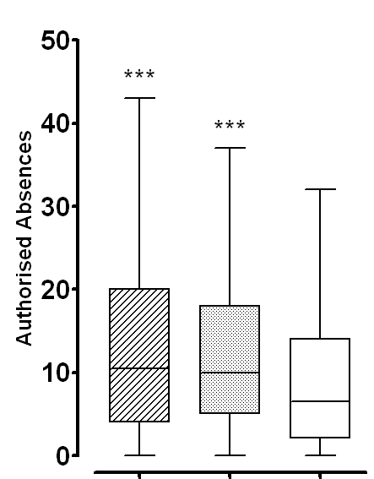
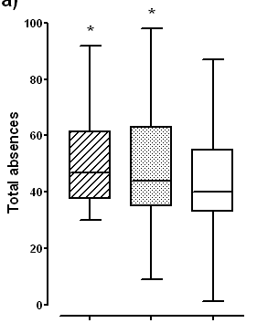
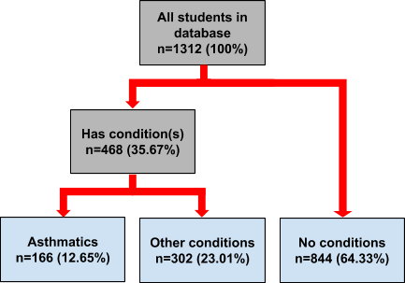
Centre for Paediatrics, Blizard Institute
School absenteeism in young people with asthma: a cross-sectional study
Samson Asher Williams
Background
Asthma is a common chronic respiratory disease that affects around 1 in 11 children and young people in the UK (Asthma UK, 2013). Evidence from the United States of America has demonstrated that children with asthma are more likely to take time out of school then their peers without asthma, particularly if they suffer from persistent or severe asthma symptoms (Moonie et al, 2006). High levels of absence are associated with poorer educational outcomes and thus, children with asthma may be at increased risk of educational failure (Silverstein et al, 2001). UK data on this issue has been lacking. This cross-sectional study aimed to measure the extent of school absenteeism in young people with asthma in the UK.
Results (2)
When separated into quartiles by total absences, the differences between the groups were unevenly distributed, with more pronounced differences the lower the quartile. The biggest difference was seen between Q1 of students with asthma and Q1 of students with no health conditions, with a mean difference of 7.458 days of total absence (95%CI=0.177 to 14.74, p=0.0458). Again, most of this difference was accounted for by authorised absences (a mean difference of 7.188 days (95%CI=2.054 to 12.32, p=0.007). There were no significant differences in the number of late attendances between any of the groups.
Methods
One secondary school in inner-city London, UK was recruited to the study via convenience sampling. The school provided an anonymised database of attendance records and health information for 1312 students. Students were separated into 3 categories according to the health information recorded in the database: students with asthma (n=166): students with health conditions other than asthma (n=302); and students with no health conditions (n=844)(see figure 1). Attendance records for total absences, authorised absences, unauthorised absences and lateness were compared between the groups.
Fig 2. Box and Whisker diagram comparing authorised absences between the asthmatic, other conditions and no conditions groups. (*** indicates significant difference (p=<0.0001) compared to no conditions)
Fig 3. Box and Whisker diagram comparing total absences between quartile 1 of the asthmatic, other conditions and no conditions groups. (* indicates significant difference (p=<0.05) compared to no conditions)
Fig 1. Participant flow chart
Asthma
Other conditions
No
conditions
Asthma Q1
Other conditions Q1
No
conditions Q1
Discussion and conclusion
Secondary school students with asthma are significantly more likely to have authorised absences from school compared to students without health conditions and are more likely to have very high levels of absence. This small data set provides evidence that resonates with observations seen in the USA. The limited nature of the information available in the dataset does not allow conclusions to be drawn about the underlying reasons behind these results. The impact of potential confounding factors, such as socio-economic class or severity of illness cannot be taken into account here. A much more extensive prospective observational study is currently being conducted by the Centre for Paediatrics to measure the impact that asthma has on the education of young people in the UK and its associated factors.
Results (1)
Students with asthma had significantly more total absences than students with no health conditions (mean difference of 3.43 days (95%CI=0.057 to 6.803, p=0.047). There was no significant difference between the number of unauthorised absences between these groups and much of the total difference was accounted for by authorised absences (mean difference of 3.961 days (95%CI=2.193 to 5.73, p=<0.0001)). There was a smaller non-significant increase in total absence in students with other health compared to students with no health conditions (mean difference of 2.396 days (95%CI=-0.3618 to 5.153, p=0.089)). However, this smaller total difference was made up of significantly more authorised absences and significantly fewer unauthorised absences. Students with asthma did not have significantly more total absences than students with other health conditions.
References
•Asthma UK, 2013, Asthma facts and FAQ, Available online, http://www.asthma.org.uk/asthma-facts-and-statistics [Accessed on 03/09/14 •Moonie SA, 2006, Asthma Status and Severity Affects Missed School Days, Journal of School Health, 76(1) pp18-24
•Silverstein MD et al, 2001, School attendance and school performance: A population-based study of children with asthma, The Journal of Pediatrics, 139(2) pp278-283
blizard.qmul.ac.uk/centres/centre-for-paediatrics

