Slide 1
Toolkit for NHS organisations: supporting the NHS to reduce its impact on air pollution
Case studies and examples to support organisations to reduce their impact on air pollution

Slide 2
Thanks for pledging to reduce your organisation’s contribution to air pollution
92% of our world is exposed to polluted air causing an estimated 7 million premature deaths every year.
Air pollution in the United Kingdom has long been considered a significant health issue. Many major cities like London are found to be significantly and regularly above legal and recommended levels. Air pollution in the UK is a major cause of diseases such as asthma, lung disease, stroke, and heart disease, and is estimated to cause forty thousand premature deaths each year, which is about 8.3% of deaths, while costing around £40 billion each year
NHS organisations may be some of the largest in any given local area, with one of the biggest estates, and one of the largest workforces. They may hold contracts worth millions of pounds with many different companies to provide goods and services. They are a major player in the local economy.
Because of their size, they could well be a major polluter in the local area. But their size could also be part of the solution, both through actions, and expectations of the companies that supply them with those goods and services.
This toolkit is designed to help you to think of ways that your NHS organisation can help London to reduce the level of air pollution to help make London one of the healthiest cities in the world and to reduce the impact air pollution has on asthma in children in London.
The toolkit pulls together a range of ideas to implement. The innovations range from those that are quick, easy and free to those that may require more work to implement or some additional funding. We have also outlined some innovations that can help you to save your organisation money. All the innovations have been taken from case studies which have been implemented elsewhere or from research which proves they are effective. Links to more information are included.

Slide 3
Ideas which are free to implement

Slide 4
Types of innovations an NHS organisation could implement
Information giving
Free Innovations
Cost saving Innovations
Procurement
Nature
Innovations which cost the organisation
Behaviour change
Travel
Innovation
Buildings/ Estates
Measuring your impact

Slide 5
Encouraging staff and patients to take action
Encouraging staff and patients to take action is an easy and fast way to help to reduce levels of air pollution:
Encourage staff to travel to work in a different way:
  Cycle to work schemes
  Walk to work schemes
  Use of public transport
  Carpooling
  If you work in a hospital with shuttle transport between sites, encourage staff to use it
  Let staff and patients know about alternative routes to your sites that avoid congested roads
    Produce maps for staff and patients to key places around your site (e.g. to the nearest tube/train station or the nearest pharmacies)
  Let patients know about the local transport routes and timetables to and from the site, such as this one: https://www.bhrhospitals.nhs.uk/plan-your-journey
  Driving does not only increase levels of air pollution for walkers. Drivers are in fact exposed to higher levels of air pollution in their cars than people walking, so cause more harm to themselves than to others. Walking therefore reduces air pollution exposure for society in general and drivers in particular.

Slide 6
Encouraging staff and patients to take action
Encourage staff and patients to take action whilst at work but also let them know about local activities and schemes that can help to reduce the levels of air pollution in London through their day to day life.
These are some examples of initiatives/schemes you can signpost people to:
- Displaying your local air quality/sustainability campaigns or initiatives
BlalaCar – trusted carpooling platform https://www.blablacar.com/
Zip car – car sharing and hiring in London http://www.zipcar.co.uk/car-hire-london
Toogoodtogo – an app that signposts people to food which is sold at reduced prices from food stores at the end of the day to avoid food waste https://toogoodtogo.co.uk/en-gb
Streetbank – a platform for sharing or giving away items you don’t use very often with your neighbours, rather than buying more things you won’t use https://www.streetbank.com/splash?locale=en. See also freecycle.
National Park City – a group of volunteers across London aiming to make London a greener and healthier place to live http://www.nationalparkcity.london/
National Garden Scheme provides unique access to over 3,700 exceptional private gardens in England and Wales, and raises impressive amounts of money for nursing and health charities through admissions, teas and cake. https://ngs.org.uk/
Click Collect London - Encourage your employees to use Click and Collect services instead of having items delivered to their home or to work it reduces congestion and the impact on air quality.

Slide 7
Engine idling
Stopping engine idling is an easy and free way to help to reduce the NHS contribution to air pollution. Engine idling is keeping your engine on whilst stationary for a length of time. It increases the amount of exhaust fumes in the air. Research indicates that if you are waiting longer than 10 seconds, switching your engine off and on again can reduce unnecessary pollution. This could involve vehicles waiting outside your organisation, including:
Patient transport
Patients’ own vehicles, or friends/family members picking them up
Staff transport
Deliveries to the organisation
Sending messages out to staff and patients through newsletters, signs and posters at reception and elsewhere, and, for example, using volunteers, can help to remind drivers to turn their engines off while they wait.
Why not work with other organisations in your area or across your network to try to promote this further? For example, see if schools, colleges, or local authority buildings can help maximise the impact, and work out how much pollution you have prevented together.
Idling Action Londonis jointly led by the City of London Corporation and the London Borough of Camden. The campaign is funded by the Mayor’s Air Quality Fund.
Notes:
Just checked and the terminology is wrong on this. Engine idling is not switching off, so we want people to stop it

Slide 8
Case Study – Clean Air, Yeah! Great Ormond Street Hospital
Great Ormond Street NHS Foundation Trust (GOSH) and Global Action Plan launched the first ever Clean Air Hospital Framework in 2019. This is a strategy aimed at improving air quality in and around hospitals in order to create a healthier environment for patients and their families, staff, and the local community.
They also worked with patients on a project that aimed to promote cleaner air around the hospital. They created a suite of tools to encourage drivers to turn their engines off in front of the hospital and to encourage visitors to stop coming to the hospital in polluting vehicles.
A case study from the Sustainable Development Unit (SDU) on their air pollution work demonstrated how, in staff presentations, they encouraged drivers not to idle their engines, and by designing eye catching signs and illustrated walking maps, they helped patients to find their way to the hospital more easily.
Read the case study here
GOSH also produced a video about children’s views on pollution and what can be done to improve it for patients:
https://www.youtube.com/watch?v=r9kEYY0mFrs

Slide 9

TFL toolkits
As part of TfL Cycling Workplaces, organisations (with five or more staff) can get the following for free:
  Free cycle parking products (the workplace funds installation)
  Cycle safety seminars – to help start cycling and provide key skills
  On bike cycle training at work (taster and 121s) – to build confidence and skills
  Cycle safety checks – to ensure bikes are safe
TfL’s Walking Tube map shows the walking times between adjacent stations on the same tube line in zones 1-3. A steps version shows the approximate number of steps.
You could also reward your staff with 50% off London Cycling Campaign membership

Slide 10
Showing your support for the Mayor’s air quality campaign
One simple way of helping to improve London’s air quality is by supporting some of the campaigns that are already going on. This may include those mentioned in this toolkit or the Mayor’s air quality initiatives for the capital. Ways of getting involved could include writing public letters of support for the initiatives and the positive impact they could have on health.
Local boroughs have to complete a Local Air Quality Management framework each year to review and improve the air quality within their areas. A report outlining the findings and action taken by local boroughs can be found below. For more local information, contact your local borough to see how you can align your organisation’s plans to that of the local borough.
LOCAL AUTHORITIES AND AIR QUALITY A summary of action taken by London boroughs to improve air quality (2019)
Finalisation of revised London local-air-quality-management

Slide 11
Air Quality: Partnership working
More than two million Londoners living in areas exceeding legal air limits – including 400,000 children
9, 400 died in capital last year due to air pollution
The Mayor has introduced ULEZ (Ultra Low emission zone) and an electric vehicle infrastructure
Mayors Green Fund (£1.27m) to create green spaces, community gardens and playground pollution barriers
29 schools – restricting road use, upgrading boilers, tackling idling engines, school air quality audits
Promoting walking and cycling
Plants and hedges
Air quality maps
Air Quality monitors including in school backpacks

Slide 12
Clean Air, Better Business
The Clean Air, Better Business campaign is run by the Cross River Partnership, a public-private partnership which has been delivering regeneration projects in London since 1994.
One of its key aims is to improve air quality and reduce the city’s carbon footprint.
To support this the campaign has developed a suite of documents to help businesses reduce their impact on London’s air quality, which includes:
Options for redirecting personal deliveries
Delivery and servicing plan case studies
Information on transportation and supply chains
They have also developed a clean air route finder to help people to reduce their exposure to air pollution:
https://www.cleanairroutes.london/

Slide 13
Ideas which can help to save the organisation money

Slide 14
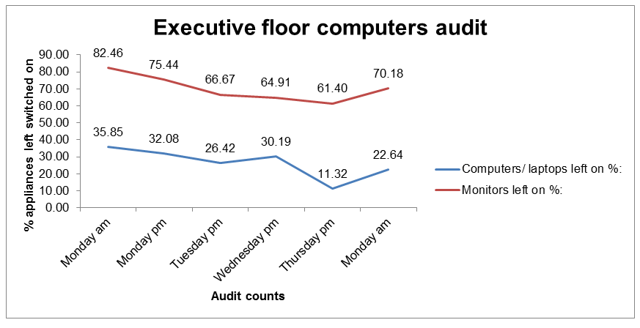
Switching Off
Over the 2015 Christmas period, there was an overall reduction in energy spending across the Royal Free London NHS Foundation Trust from people switching electrical items off, of £7,856.
Interested to see whether these cost and emissions savings were replicable all year round, the Trust audited its executive offices and found that, in an office of 60 desks, £7,952 savings were achievable throughout the year if more people switched their desktops, screens, printers, projectors, air-conditioning, and other electrical appliances off when they went home at night or over the weekend.
The Royal Free, at the time, had a total staff of over 10,000 people. If almost £8,000 savings were achievable from 60 people, that’s a whopping £1,333,333 over a year that they could save if everybody switched things off at night or at weekends

Slide 15
Reviewing the products you buy in the organisation
Many different products and services which are bought in the NHS can have an impact on the quality of the air both inside and outside. Reviewing the products and services you buy and how they impact the contribution of your organisation to London’s air quality could help to reduce your contribution and save your organisation a considerable sum too.
Buying more sustainable products: http://www.sduhealth.org.uk/documents/case_study/20160913_Case_Study_SDU_procurement_designed.pdf
Ethically sourced surgical gloves
Thinking about your organisation’s energy usage:
A new approach to procurement: Ultra efficient lighting - Rotherham
Energy- automatic system for switching off computers in NHS Oldham
        Energy efficiency, Finance, Estates Management, Carbon reduction in Blackpool NHG Foundation Trust

Slide 16
Reducing waste in your organisation – Barking Havering and Redbridge University Hospital Trust
Barking Havering and Redbridge University Hospitals Trust has run a number of projects over the last few years to reduce its contribution to air pollution. Some examples of the work and its impact are detailed below.
Reducing waste in theatres:
Messaging to staff and the public and demonstrating success:
Sustainability: working to reduce our carbon footprint
Energy Savings:
Travelling to the trust, encouraging the use of public transport and walking routes :
  https://www.bhrhospitals.nhs.uk/plan-your-journey

Slide 17
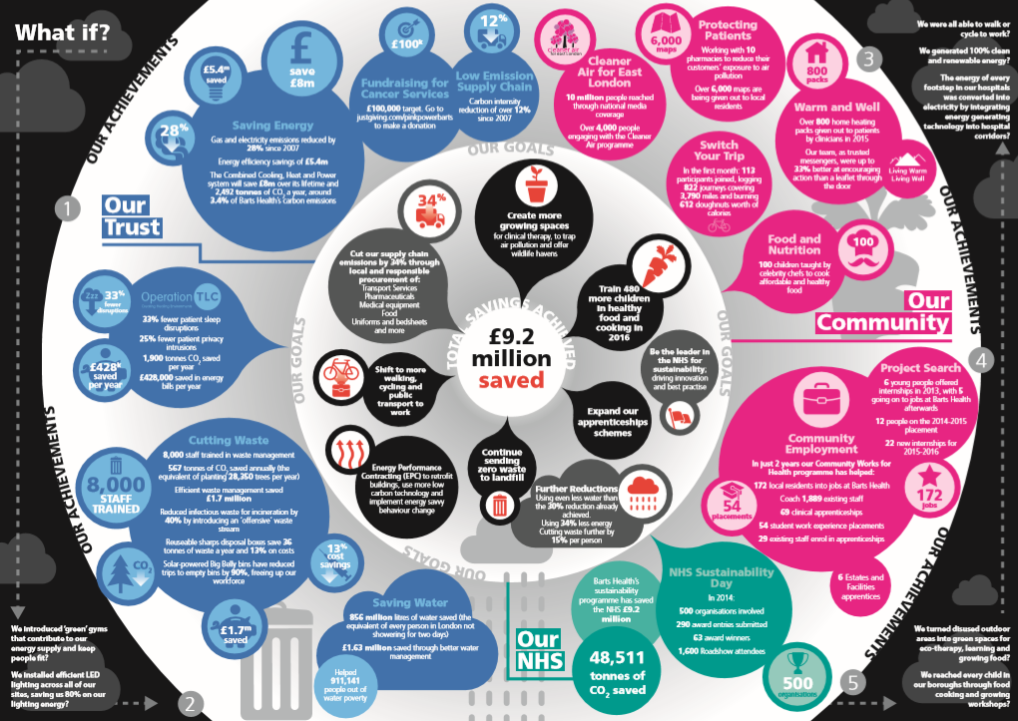
Reducing waste in your organisation – Barts Health
Barts Health have also done a lot of work over the last few years to become more sustainable and reduce their impact on emissions whilst saving £9.2million. Take a look at these resources they have created to get some ideas:
A video demonstrating how they implemented it:
https://youtu.be/FCAskWHuye8
An infographic with all their innovations and project:
A link to their vision for 2020:
https://www.bartshealth.nhs.uk/download.cfm?doc=docm93jijm4n664.pdf&ver=931

Slide 18
Saving on staff time and travel costs
Encouraging staff to cycle or walk to work benefits their health and the local environment. If you can reduce travel between sites during the day, by encouraging teleconferencing and virtual meetings, you can also reduce costs and increase staff productivity. Something positive that has come out of COVID-19 is this is now commonplace
Examples:
Saving Staff Time and Travel Costs Through Virtual Meetings - Leeds CCG
Teleconferencing Derbyshire
Travel Plan North Lincolnshire & Goole Hospitals Foundation Trust

Slide 19
Bulk deliveries
NHS organisations may have hundreds of contracts with many different suppliers, which can result in many of different deliveries arriving on a daily basis. One of the ways of improving your contribution to air quality is by streamlining your deliveries to the organisation and encouraging deliveries to be arranged in bulk.
This should form a key component of procurement and buying strategies. It also helps to reduce congestion around sites. It can also reduce delays on public transport by reducing traffic, so your patients are more likely to arrive on time and not miss their appointments.

Slide 20
Circular economy
A circular economy is a restorative and regenerative approach to keep products, components and materials at their highest utility and value. The idea is that it removes waste from the system by using resources or their component parts to their maximum capacity. For example, if a part of a machine has broken and can’t be replaced, how are all the other working parts of the machine being used to maximise their use. This should also help patient care and experience. Instead of waiting for weeks to replace faulty equipment, get component parts replaced or fixed quickly and save money in the process.
The Ellen Macarthur Foundation is leading research and implementation of these principles by working with large companies, academic institutions and top business leaders to spread good practice. Have your suppliers signed up?
If yes, are they acting this way? Make sure that you hold them to account.
If no, which other organisations use them? Can you group together to influence them to sign up?
https://www.ellenmacarthurfoundation.org/circular-economy

Slide 21
Ideas which may cost the organisation to implement

Slide 22
A Green Fingered NHS
How you can use plants to improve air quality
Although this does require some expenditure from the organisation, it can be a low-cost way to improve your contribution to London’s air pollution. Here are 3 suggestions of different things you can plant:
Plant nitrogen fixing plants – these are plants which thrive on nitrogen and collect the nitrogen from the air (as opposed to the soil) and store it in their roots: e.g. clover, rooibos, honeybush, indigo, lupins. Legumes and beans also have these properties. Why not grow your own beans and peas at your organisation to support your staff and patients to eat healthily too!
Improve your indoor air quality with plants – indoor air quality can also contribute to poor health outcomes, consider lavender, eucalyptus, aloe vera, spider plants, and snake plants.
Green Walls, Green Roofs, rooftop gardens and tiny parks – These initiatives require a little more investment and time but they have a greater impact in reducing the levels of nitrogen and carbon in the air. Many hospitals already have Green Walls and you can see edible bus stops and underground “parks” on the tube in London already.
http://theediblebusstop.org/ www.energygarden.org.uk

Slide 23
Turn the pollution from your vehicles into ink
Graviky Labs have designed a form of technology which captures the pollutants from the exhaust of a vehicle and upcycles air pollution into sustainable inks, paints, coatings, plastics and construction materials
Graviky Labs have estimated that if all the cabs in London were fitted with the device there would be 30 trillion litres of clean air each year – imagine what it could be if all NHS vehicles in London were fitted with these devices.
http://www.graviky.com/

Slide 24
Recycle your coffee cups
Many NHS sites have coffee shops selling takeaway coffee on site. Takeaway coffee cups are renowned for being difficult to recycle. However a new innovation has started to recycle these cups to reduce waste levels.
London started to place coffee cup bins around the city and Liverpool Street Station and in one month they collected 509,091 cups – which can now all be recycled into new products. What impact would this have if all NHS trusts in London did the same?
This could be as simple as placing bins around your organisation or you could go even further and work with the contracted provider to demonstrate how they are trying to reduce their impact on London’s air pollution.
www.nextcupcycle.co.uk

Slide 25
Innovations which help to produce energy and remove particulates
Pavegen – This company have developed tiling which can generate kinetic energy and renewable electricity from foot-steps. Installing it in places where there are large numbers of people walking can generate electricity for the organisation. http://www.pavegen.com/
CityTree – this bench and pollution filter has been developed to remove nitrogen dioxide and particulate matter from polluted air. It is solar powered so completely self sufficient https://greencitysolutions.de/en/
Airlite – A company which develops paints to reduce air pollution including nitrogen oxide and nitrogen dioxide. http://www.airlite.com/

Slide 26
Worried about cost? Involve your Trust charity
For hospitals, Trust charities may be able to help with the potential costs of some of these suggestions. They have a remit to pay for equipment that will improve patient care and patient experience, or to help organisations make financially sustainable investments.
By improving air quality, you will improve the experience of patients with respiratory conditions, especially young patients, who feel the effects of pollution more harshly than adults.
Air pollution can aggravate clinical symptoms, so by taking steps to reduce it, you are also more likely improve clinical outcomes for patients.
As well as ideas that save money by reducing expenditure on non-clinical costs, improving patient experience and outcomes is another good way to reduce expenditure in the long-run.
Remember, all of these are exactly the kinds of things that a Trust charity is there to support with.

Slide 27
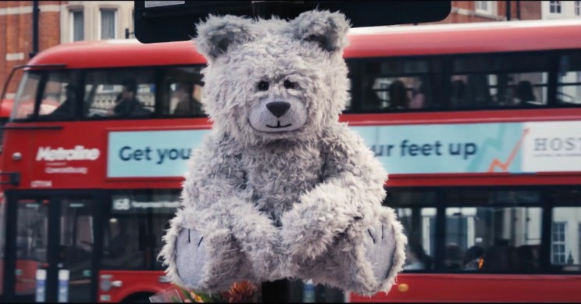
Air Quality Monitoring
An air quality monitor is a device that measures the level of common air pollutants. Monitors are available for both indoor and outdoor settings. Indoor air quality monitors are typically sensor based instruments. Some of them are able to measure ppb levels and come as either mixed gas or portable units
Monitoring and predicting air quality
Toxic Toby -higher the pollution more he coughs

Slide 28
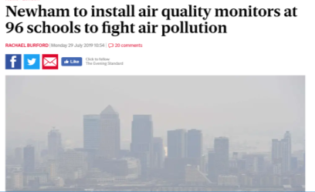
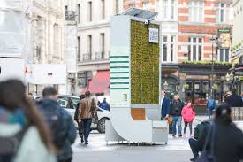
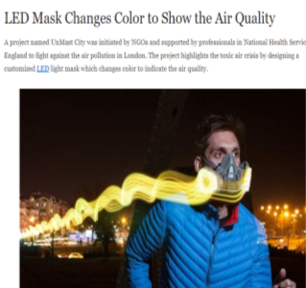
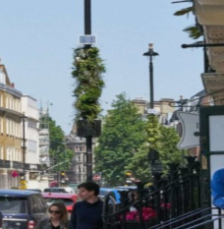
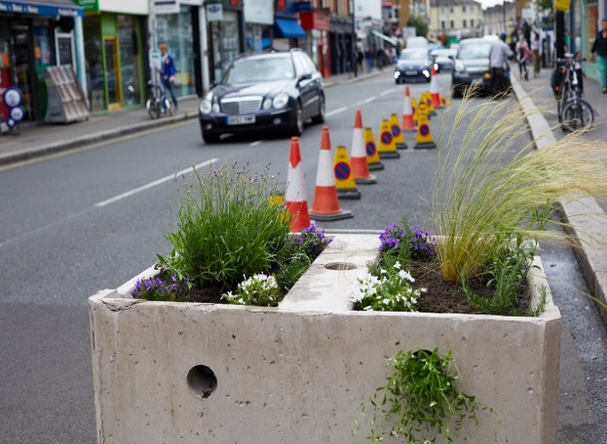
Air Quality: Innovation
Google street view cars monitoring air pollution
Green road blocks to reduce post lockdown traffic
Notes:
This London bench absorbs as much pollution as 275 trees Each CityTree holds 1,682 pots of moss which, its creators claim, extract as much particulate matter as 275 trees in one per cent of the space
Toxic toby speaks as people pass

Slide 29
Useful links
Clean Air Day https://www.cleanairday.org.uk/
DEFRA – for latest air quality measurements and pollution forecasts https://uk-air.defra.gov.uk/
Free Air Pollution Helpline - Defra also provides a free automated telephone service on 0800 55 66 77. This provides the 5-day descriptive forecast text and latest data by region as well as health advice.
MET Office - Information on how to use the daily air quality index including additional advice for susceptible individuals. https://www.metoffice.gov.uk/weather/guides/air-quality
AIR Quality England - latest near-real-time air quality data for UK Government, local authorities and the private sector across England https://www.airqualityengland.co.uk/
London Air, the website of the London Air Quality Network, is managed by King’s College London. As well as data, forecasts and summaries this website also provides downloadable mobile phone apps allowing Londoners to check out air quality in their city, while out and about
Text Messaging Services such as “AirText” in London and the South East,
SUSTRANS Charity making it easier for people to walk and cycle
Explore pollution data on a 3D map of the city through Google Earth.

Slide 30
References
Royal College of Paediatrics and Child Health: Position statement https://www.rcpch.ac.uk/resources/outdoor-air-quality-uk-position-statement
Royal College of Physicians
https://www.rcplondon.ac.uk/projects/outputs/every-breath-we-take-lifelong-impact-air-pollution
World Health Organisation
https://www.who.int/en/news-room/fact-sheets/detail/ambient-(outdoor)-air-quality-and-health
https://www.who.int/health-topics/air-pollution#tab=tab_1
Who Air quality-and-health video library
British Heart Foundation:
Air Quality and the NHS

Slide 31
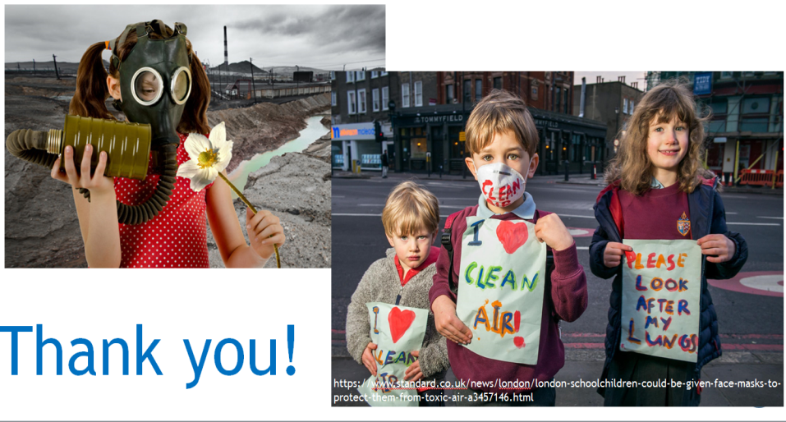
Thank you for helping

