Slide 1
Patterns and trends in child obesity in London

Slide 2
Child Obesity in London
Trend in the prevalence of obesity and excess weight
by age (Reception and Year 6), London
Reception (aged 4-5 years)
Year 6 (aged 10-11 years)
Prevalence (%)
Prevalence (%)
excess weight
excess weight
obese
obese
Child excess weight BMI ≥ 85th centile, child obesity BMI ≥ 95th centile of the UK90 growth reference.
95% confidence intervals are displayed on the chart
Source: National Child Measurement Programme

Slide 3
Child Obesity in London
Trend in the prevalence of excess weight
by sex and age (Reception and Year 6), London
Prevalence (%) of excess weight
Year 6
Boys
Girls
Reception
Boys
Girls
Child excess weight BMI ≥ 85th centile of the UK90 growth reference. 95% confidence intervals are displayed on the chart
Source: National Child Measurement Programme

Slide 4
Child Obesity in London
Trend in the prevalence of obesity
by sex and age (Reception and Year 6), London
Prevalence (%) of obesity
Year 6
Boys
Girls
Reception
Boys
Girls
Child obesity BMI ≥ 95th centile of the UK90 growth reference. 95% confidence intervals are displayed on the chart
Source: National Child Measurement Programme

Slide 5
Child Obesity in London
Prevalence of excess weight
by age (Reception and Year 6), London
Over one in five children in Reception is overweight or obese (boys 22.7%, girls 21.6%)
Over one in three children in Year 6 is overweight or obese (boys 39.6%, girls 34.7%)
Child overweight (including obesity)/ excess weight: BMI ≥ 85th centile of the UK90 growth reference
Source: National Child Measurement Programme 2014/15

Slide 6
Child Obesity in London
Prevalence of obesity
by age (Reception and Year 6), London
Around one in ten children in Reception is obese (boys 10.6%, girls 9.7%)
One in four boys and one in five girls in Year 6 is obese (boys 25.0%, girls 20.2%)
Child obesity: BMI ≥ 95th centile of the UK90 growth reference
Source: National Child Measurement Programme 2014/15

Slide 7
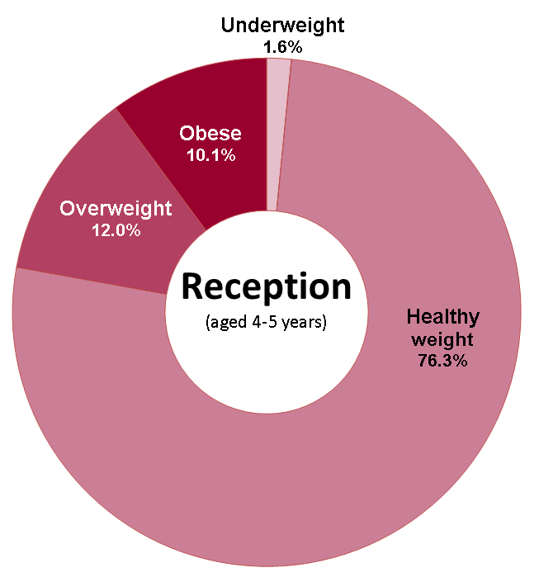
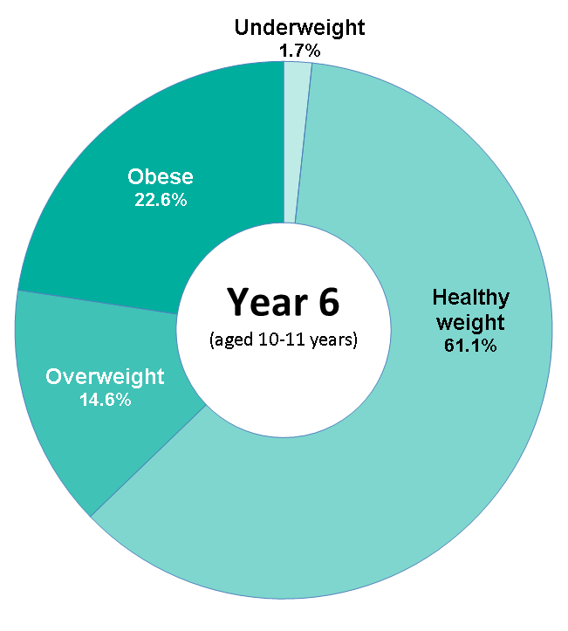
Child Obesity in London BMI status of children by age, 2014/15
This analysis uses the 2nd, 85th and 95th centiles of the British 1990 growth reference (UK90) for BMI to classify children as underweight, healthy weight, overweight and obese. These thresholds are the most frequently used for population monitoring within England.
Source: National Child Measurement Programme 2014/15

Slide 8
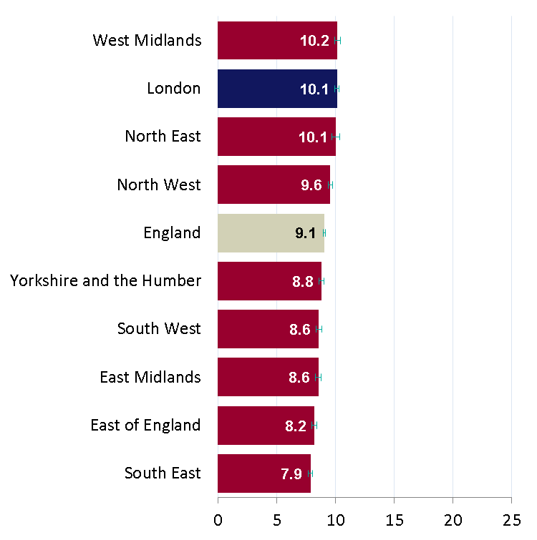
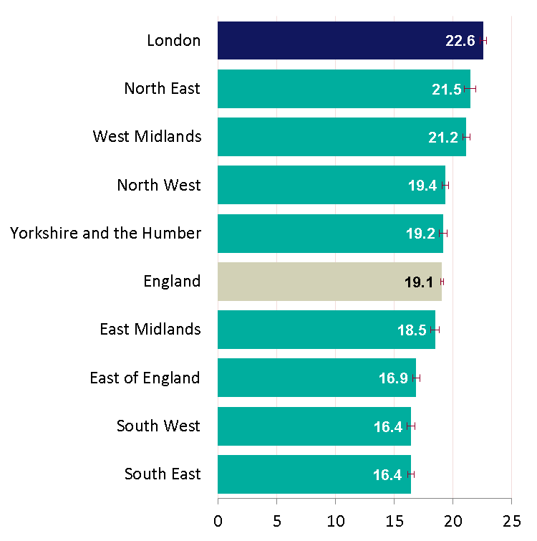
Child Obesity in London
Prevalence of obesity by age, 2014/15
England and Regions
Children in Reception (aged 4-5 years)
Children in Year 6 (aged 10-11 years)
Percentage obese
Percentage obese
Child obesity: BMI ≥ 95th centile of the UK90 growth reference
Source: National Child Measurement Programme 2014/15
Notes:
In this analysis postcode of school has been used to calculate regional data.

Slide 9
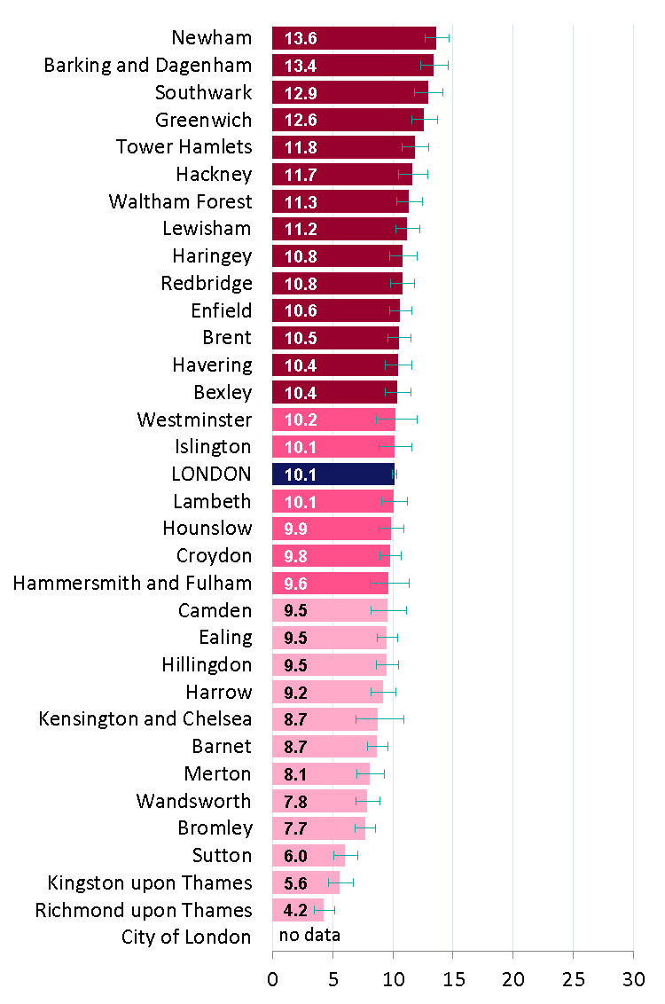
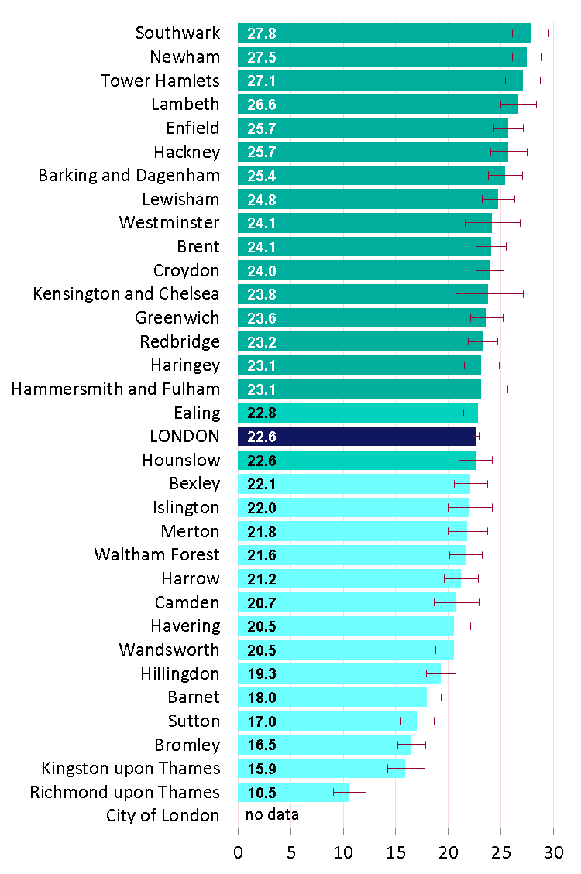
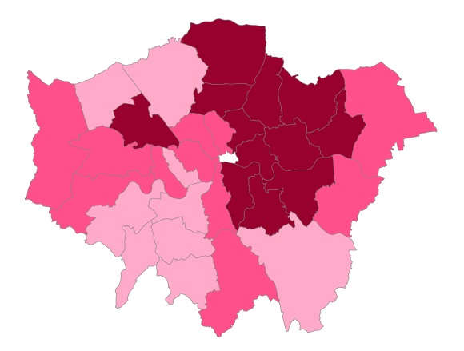
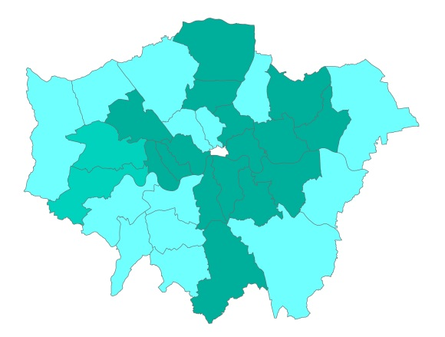
Child Obesity in London
Prevalence of obesity by age, 2014/15
London Boroughs
Children in Reception (aged 4-5 years)
Children in Year 6 (aged 10-11 years)
Percentage obese
Percentage obese
Child obesity: BMI ≥ 95th centile of the UK90 growth reference
Source: National Child Measurement Programme 2014/15
Notes:
In this analysis postcode of school has been used to calculate area data.

Slide 10
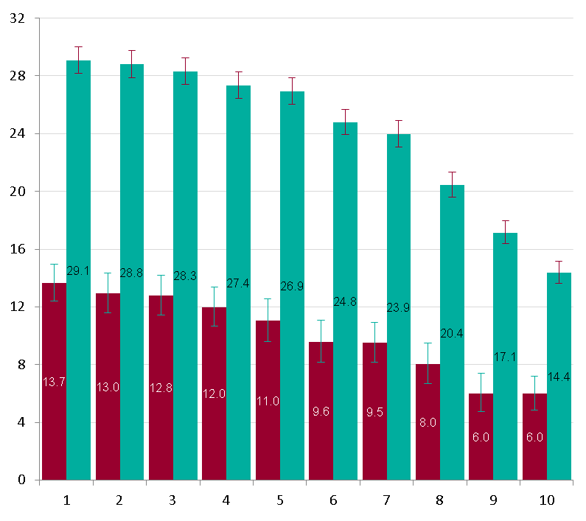
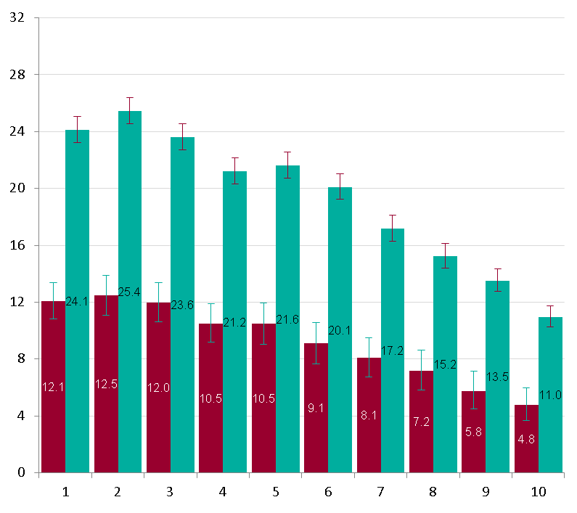
Child Obesity in London
Prevalence of obesity by deprivation decile*
by sex and age (Reception and Year 6), London
Prevalence (%) of obesity
Boys
Prevalence (%) of obesity
Girls
Most deprived
Index of Multiple Deprivation 2015 deciles
Least deprived
Most deprived
Index of Multiple Deprivation 2015 deciles
Least deprived
Reception (aged 4-5 years)
Year 6 (aged 10-11 years)
* Deprivation deciles for London
Child obesity: BMI ≥ 95th centile of the UK90 growth reference
Source: National Child Measurement Programme 2014/15 (Unpublished data)
Notes:
The deprivation deciles in this analysis have been assigned using the LSOA of residence of children measured.
They are the deprivation deciles for London, using IMD 2015.

Slide 11
Child Obesity in London
Prevalence of obesity by ethnic group
by sex and age (Reception and Year 6), London
Reception (aged 4-5 years)
Year 6 (aged 10-11 years)
Girls
Boys
Percentage obese
Percentage obese
Child obesity: BMI ≥ 95th centile of the UK90 growth reference
Source: National Child Measurement Programme 2014/15 (Unpublished data)

