Slide 1
Workforce Planning – Children and Young People (CYP) Services
A POPULATION AND PATIENT CENTRED APPROACH FOR PRIMARY CARE NETWORKS (PCNs)
Starting with patients
01
A whole population approach and patient segmentation considering commissioning intentions, national and local priorities, demographic demand etc.
Develop transformation plan
By gathering the information on the requirements, a transformation plan can be developed and could include; developing the existing workforce and/or recruiting funded additional roles available to PCNs
05
02
Defining the vision
Understanding what the ideal workforce should look like by assessing the skills and competencies required
Assessing the gap
Understanding the deficit of workforce numbers and skills required to bridge the gap between the current workforce and future requirements
04
03
Available resources
Analysing the existing workforce resources including roles, competencies and hours worked. This should also factor in scenarios such as maternity leave, retirements, etc

Slide 2
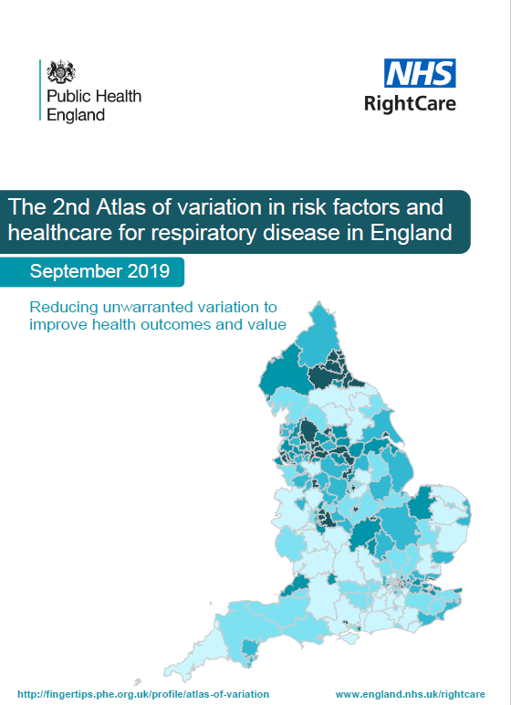
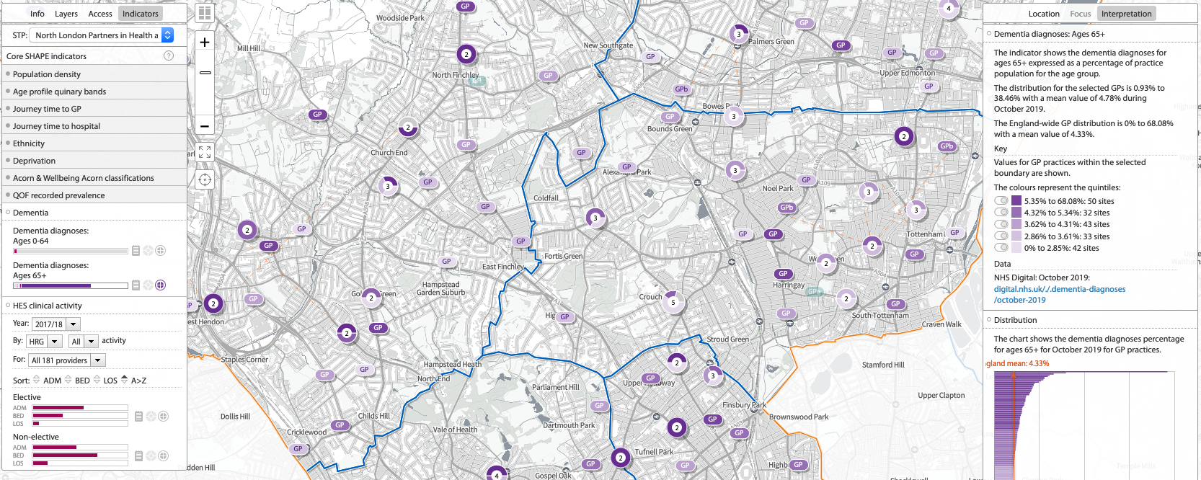
01
Starting with your local population; understanding need and demand
05
02
04
03
Fingertips – atlas of variation, Public Health England
The fingertips profiles are a rich source of indicators across a range of health and wellbeing themes that have been designed to support Joint Strategic Needs Assessment (JSNA) and commissioning to improve health and wellbeing and reduce inequalities.
They also enable PCNs to:
Browse indicators at different geographical levels
Benchmark against the regional or England average
Export data to use locally
Joint Strategic Needs Assessment (JSNA)
The JSNA is a process through which the Local Authority’s social care services (Education, Social Care and Wellbeing) work together with public health and NHS services to assess the needs of their population and determine priorities for commissioning services.
The JSNA core dataset draws together data on population demographics, disease patterns, the wider determinants of health, use of social care and use of health care services. The Local Authority publishes an overview document and more detailed fact sheets on their website. See Tower Hamlets JSNA as an example.
SHAPE Place Atlas is a web enabled, evidence-based application that informs and supports the strategic planning and delivery of services and assets across a whole health economy. SHAPE links national data sets clinical analysis, public health, primary care and demographic data with information on healthcare estates performance and facilities location.
https://fingertips.phe.org.uk/profile/atlas-of-variation
NHS Right Care ‘where to look’ packs
Where to Look packs with 2017/18 data are now available. The packs cover the main NHS programme budgeting categories including cardiovascular disease, respiratory, mental health and cancer and are personalised for each CCG.
Using demographically matched comparators, each system can develop local plans that focus on opportunities which have the potential to provide the biggest improvements in health outcomes, resource allocation and reducing unwarranted variation and health inequalities.
Access to the SHAPE Place Atlas is free to NHS and Local Authority professionals with a role in Public Health or Social Care; access to the application is by registration and license agreement. https://shapeatlas.net/user-registration/
STP clinical effectiveness dashboards
STPs often produce a dashboard to help their local providers – these dashboards provide data and analytical tools to help clinicians and care professionals understand the health and social care priorities for their local population.
Examples:
North West London – Whole Systems Integrated Dashboard
North East London – Clinical Effectiveness Group
https://www.england.nhs.uk/rightcare/products/ccg-data-packs/where-to-look-packs/#london

Slide 3
Patient centred planning – patient segmentation in child health
01
05
02
04
03
Integrated care is often built around patient pathways; within a ‘whole population’
approach, children and young people can be stratified into broad segments.
Healthy Child
Advice & prevention eg: Breast feeding / Immunisation / Mental well-being / Healthy eating / Exercise / Dental health
Child with single long-term condition
eg: Croup / Otitis media / Tonsillitis / Uncomplicated pneumonia / Prolonged neonatal jaundice
eg: Severe neurodisability / Down’s syndrome / Multiple food allergies / Child on long-term ventilation/ Type 1 diabetes
Acutely mild-to-moderately unwell child
Child with complex health needs
eg: Depression / Constipation / Type 2 diabetes/ Coeliac Disease / Asthma / Eczema / Nephrotic syndrome
Acutely severely unwell child
eg: Trauma / Head injury / Surgical emergency / Meningitis / Sepsis / Drug overdose / Extreme preterm birth
Vulnerable child with social needs
eg: Safeguarding issues / Self-harm / Substance misuse / Complex family & schooling issues / Looked after children
Identify cross-cutting themes: Examples include safeguarding, mental health, educational issues around school and transition.
Payment and Contracting mechanisms
This segmentation model also allows the activity and spend on a population of children and young people within a defined locality to be assessed and analysed.
This presents the opportunity for using different payment and contracting mechanisms for child health.
Dr Bob Klaber & Dr Mando Watson Imperial College Healthcare NHS Trust

Slide 4
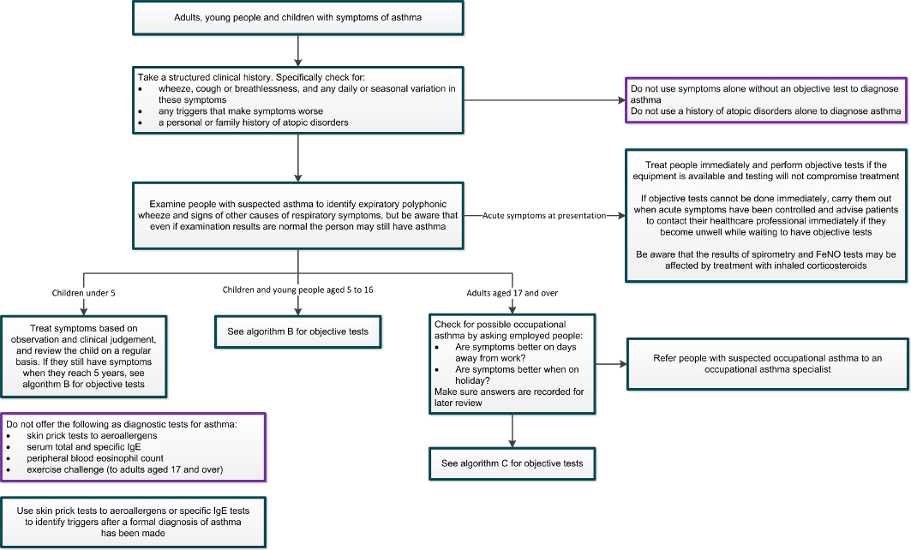
Patient centred planning – Best Practice
01
05
02
A patient-centred approach to developing services starts with researching best practice in the diagnosis, management and monitoring of known conditions
04
03
NICE guidelines
Asthma: diagnosis, monitoring and chronic asthma management
NICE provides evidence-based recommendations, including objective tests, diagnostic algorithms and recommended treatments developed by independent committees, including professionals and lay members, and consulted on by stakeholders.
Algorithm A Initial clinical assessment for adults, young people and children with suspected asthma
Clinical effectiveness group, Southwark
whilst not specifically for children and young people these guides provide an overview of the main elements involved in managing asthma including: asthma tests and diagnosis, management, including chronic and acute asthma, referrals to specialist services, device training and reviews.
http://www.clinicaleffectivenesssouthwark.co.uk/

Slide 5
01
The GP contract agreement 2020/21 to 2023/24
05
02
04
03
A patient-centred approach to developing services is guided by the national priorities set out in the new GP contract agreement and the changes to the Asthma Quality and Outcomes Framework (QOF)
The QOF for Asthma has been updated as follows:
Practices will be required to establish and maintain a register of patients aged 6 years and over with a diagnosis of asthma, in line with NICE guidance
Practices will be expected to use a minimum of two diagnostic tests to confirm an asthma diagnosis. These tests should be performed up to 3 months before any date of diagnosis and up to 6 months after this date
The content of the asthma review has been amended to incorporate aspects of care positively associated with better patient outcomes and self-management
Practices will be required to record smoking exposure in children and young people under the age of 19 years
Update to the GP Contract agreement 2020/21 to 2023/24

Slide 6
01
Worked example;
Assessing the skills and competencies required for the Asthma QOF
05
02
04
03
QOF activity | Competency | Possible roles
AST005. The contractor establishes and maintains a register of patients with asthma aged 6 years or over, excluding patients with asthma who have been prescribed no asthma related drugs in the preceding 12 months (based on NM165) | Record keeping, Database management | Practice Manager, Data clerk
AST006. The percentage of patients with asthma on the register from 1 April 2020 with either: a record of spirometry and one other objective test (FeNO or reversibility or variability) between 3 months before or 6 months after diagnosis; or if newly registered in the preceding 12 months with a diagnosis of asthma recorded on or after 1 April 2020 but no record of objective tests being performed at the date of registration, with a record of spirometry and one other objective test (FeNO or reversibility or variability) recorded within 6 months of registration. (based on NM166) | Asthma testing and diagnostics including spirometry | GP, Advanced Nurse Practitioner, Clinical Pharmacist, Physician Associate
AST007. The percentage of patients with asthma on the register, who have had an asthma review in the preceding 12 months that includes an assessment of asthma control using a validated asthma control questionnaire, a recording of the number of exacerbations, an assessment of inhaler technique and a written personalised action plan (based on NM167) | Care management and planning, device training, | GP, Advanced Nurse Practitioner, Clinical Pharmacist, Physician Associate
AST008. The percentage of patients with asthma on the register aged 19 or under, in whom there is a record of either personal smoking status or exposure to second-hand smoke in the preceding 12 months (based on NM168) | Record keeping, Database management | Practice Manager, Data clerk

Slide 7
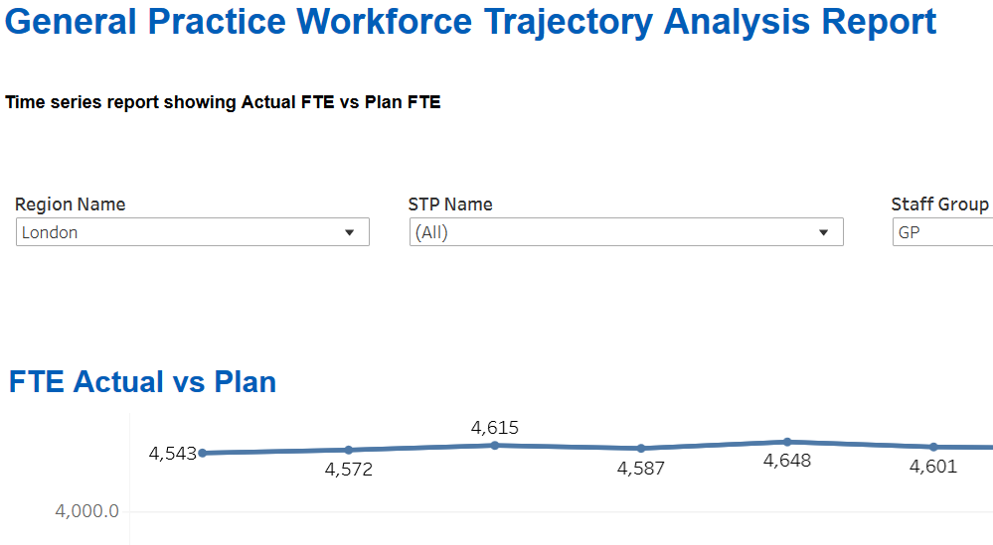
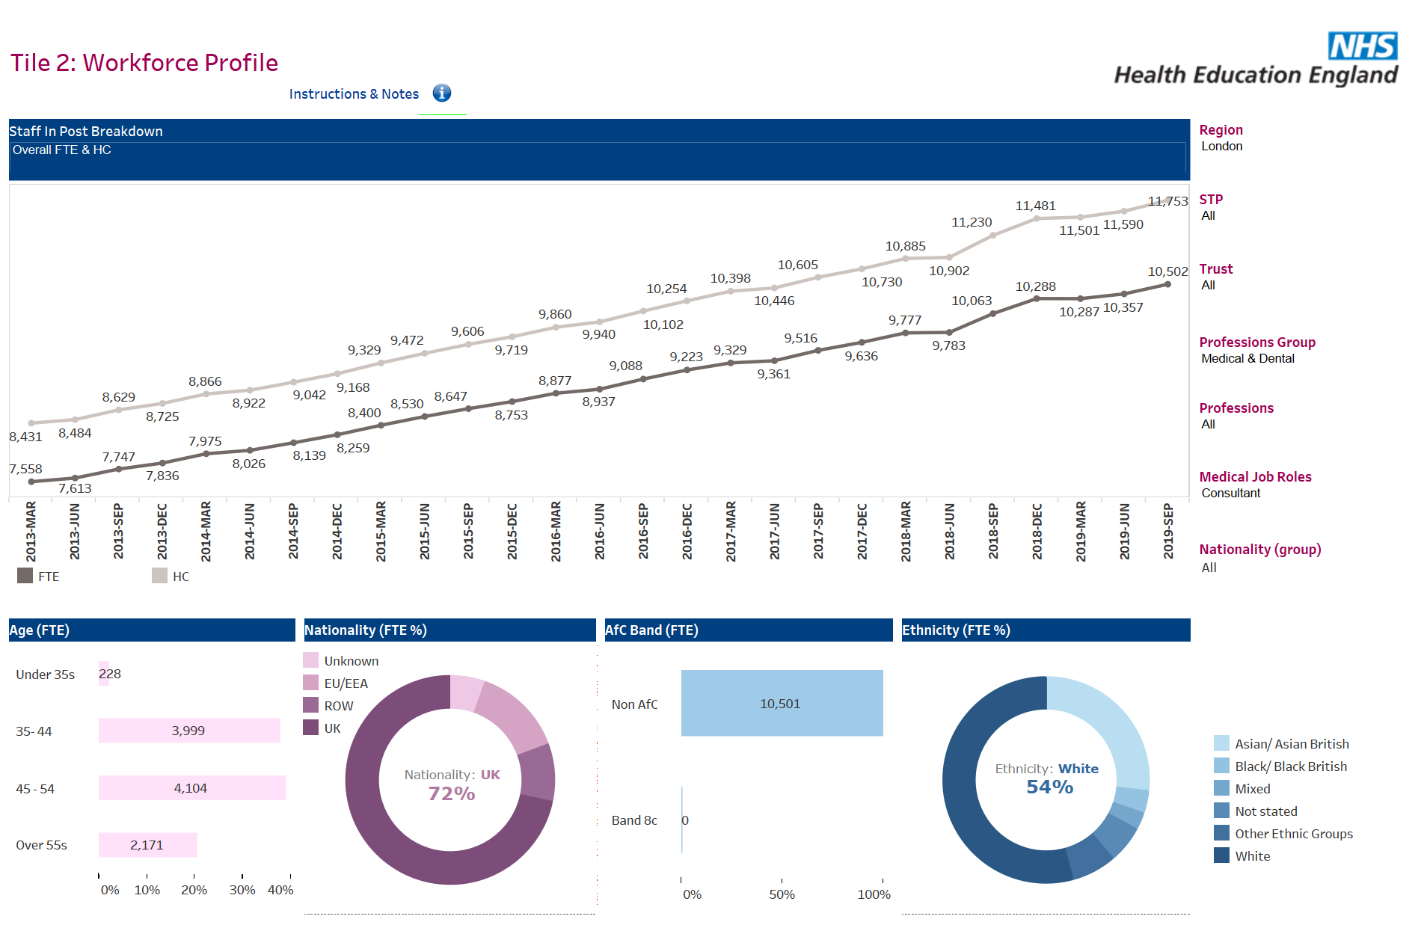
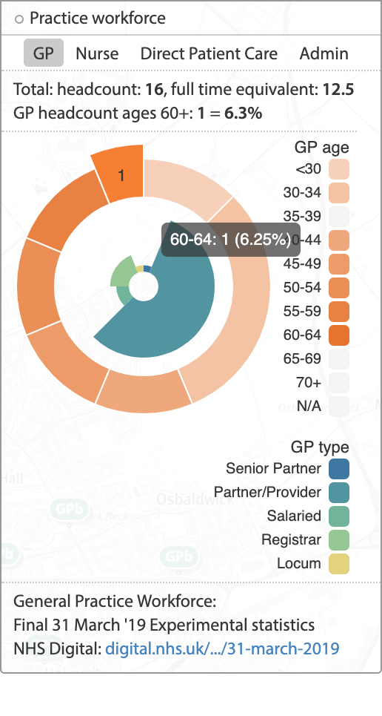
01
Quantifying existing practice and PCN workforce resources
05
02
04
03
NHS Digital and the GP workforce Census
The general practice data is collected via the quarterly GP workforce census and shows numbers and details of GPs, Nurses, Direct Patient Care and Admin/Non-Clinical staff working in General Practice in England.
The summary page for each quarter provides an overview of the workforce numbers and the detailed tables and the raw data. December 2019 is the latest data available and the summary page is here.
The General Practice Workforce Interactive Dashboard is also available on the summary page and enables the user to drill down to CCG and practice level for GP workforce numbers
FutureNHS
General Practice Workforce Trajectory Analysis Report
Derived from the GP workforce census the GP Workforce Trajectory Analysis Report provides information to show the progress of FTE from baseline against trajectory at national, regional and STP level by staff group.
Contact jonathan.sampson@nhs.net for a
futureNHS account.
HEE – Workforce Intelligence Portal
Workforce Profile – derived from ESR data for secondary care services the workforce profile displays workforce growth over the last six years allowing you to breakdown by specific demographics and filter by profession, STP or Trust.
SHAPE Place Atlas - Strategic Health Asset Planning & Evaluation
The SHAPE atlas database is updated from the NHS digital GP workforce census and allows a summary of practice and PCN workforce, for GPs, nursing and other roles, to be displayed.
SHAPE atlas allows the mapping of practices into their PCNs and for this information to be overlaid with demographic and deprivation data along with disease prevalence and Hospital Episode Statistics.
Contact dominic.hunt@hee.org.uk for
an account.
The National Workforce Reporting System (NWRS)
The NWRS is made up of two modules: 1) The data entry module is where general practices and PCNs complete their workforce information, to fulfil their requirements for the workforce Minimum Data Set (wMDS). 2) The reporting module is a suite of reports containing published, non-identifiable, based workforce data supplied by GP practices.
NWRS Workforce overview
Access to the SHAPE Place Atlas is free to NHS and Local Authority professionals with a role in Public Health or Social Care; access to the application is by registration and license agreement. https://shapeatlas.net/user-registration/

Slide 8
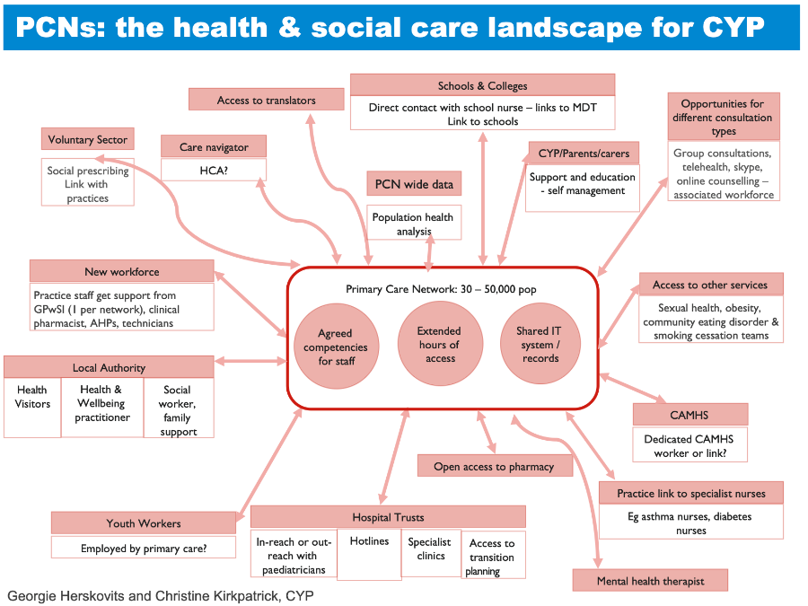
Mapping wider system resources
01
05
02
The update to the GP contract agreement published in February 2020 encourages a close working relationship between PCNs and community services providers and stakeholders in delivering services and recruiting and employing additional roles. Each PCN should map their local resources and this slide provides an overview of who those partners might be.
04
03
Community and mental health services,
Specialist clinicians in the local trust
Urgent and emergency care providers including LAS and 111
Local authority - social services and education, local schools
Voluntary sector and community resources,
Emergency services (fire, police)
Private organisations with social responsibility initiatives – eg local businesses and the football club

Slide 9
01
Worked example;
Assessing the skills and competencies gap for the Asthma QOF
05
02
04
03
QOF activity | Competency | Possible roles | Activity demand (FTE) | Existing workforce (FTE) | Workforce capacity | Transformation Plans
AST005. The contractor establishes and maintains a register of patients with asthma aged 6 years or over, excluding patients with asthma who have been prescribed no asthma related drugs in the preceding 12 months | Record keeping, Database management | Practice Manager, Data clerk | The demand implied by a particular activity can be estimated by breaking the activity into its constituent parts and the number of times that these need to be repeated in a given period. Assuming that the current levels of activity are being met by the existing workforce then it will be necessary to estimate the additional demand implied by the new contract. The full-time equivalent (FTE) is calculated as a proportion of the full working week; 37.5 hours. | See slides 7 and 8 for guidance on quantifying the existing workforce and wider community resources. | Workforce capacity is essentially the difference between the existing workforce and additional demand. Often this is measured in terms of the FTE gap. Existing capacity is also a measure of the skills and competencies of the existing workforce and may imply the need for a development programme rather the need to recruit additional staff. | The transformation options open to a PCN will depend upon the assessment of the existing workforce capacity. Could the additional demand and new skills required be met by training the existing workforce and/or realigning existing responsibilities Could the demand be met by recruiting additional new roles or working with other community providers?
AST006. The percentage of patients with asthma on the register from 1 April 2020with either: a record of spirometry and one other objective test (FeNO or reversibility or variability) between 3 months before or 6 months after diagnosis; or if newly registered in the preceding 12 months with a diagnosis of asthma recorded on or after 1 April 2020 but no record of objective tests being performed at the date of registration, with a record of spirometry and one other objective test (FeNO or reversibility or variability) recorded within 6 months of registration. | Asthma testing and diagnostics including spirometry | GP, Advanced Nurse Practitioner, Clinical Pharmacist, Physician Associate
AST007. The percentage of patients with asthma on the register, who have had an asthma review in the preceding 12 months that includes an assessment of asthma control using a validated asthma control questionnaire, a recording of the number of exacerbations, an assessment of inhaler technique and a written personalised action plan | Care management and planning, device training, | GP, Advanced Nurse Practitioner, Clinical Pharmacist, Physician Associate
AST008. The percentage of patients with asthma on the register aged 19 or under, in whom there is a record of either personal smoking status or exposure to second-hand smoke in the preceding 12 months | Record keeping, Database management | Practice Manager, Data clerk

Slide 10
Workforce transformation; recruiting new roles in PCNs
01
05
02
04
03
Mental Health Practitioner
2021/22
AfC Band: TBC
Reimbursement: TBC
Through the Additional Roles Reimbursement Scheme, PCNs across England will be guaranteed funding for up to 26,000 additional staff by 2023/24 - approximately 15 roles per PCN.
The update to the GP contract agreement published in February 2020 gives PCNs additional flexibility with a choice of 10 roles that are eligible for reimbursement.
PCNs do not have to employ these roles directly and can work with community-based partners such as GP federations, community trusts, local authorities, etc.
Further guidance on the additional Roles reimbursement Scheme can be found here.
Care Co-ordinator
2020/21
AfC Band: 4
Reimbursement: £29,135*
Clinical Pharmacist
2019/20
AfC Band: 7-8a
Reimbursement: £55,670*
Health & Wellbeing Coach
2020/21
AfC Band: Up to 5
Reimbursement: £35,389*
Social Prescribing Link Worker
2019/20
AfC Band: Up to 5
Reimbursement: £35,389*
Chiropodist/Podiatrist
2020/21
AfC Band: 7
Reimbursement: £53,724*
Primary Care
Network
First Contact Physiotherapist
2020/21
AfC Band: 7-8a
Reimbursement: £55,670*
Dietician
2020/21
AfC Band: 7
Reimbursement: £53,724*
Physician Associate
2020/21
AfC Band: 7
Reimbursement: £53,724*
Occupational Therapist
2020/21
AfC Band: 7
Reimbursement: £53,724*
Pharmacy Technician
2020/21
AfC Band: 5
Reimbursement: £35,389*
Community Paramedic
2021/22
AfC Band: 7
Reimbursement: £53,724*
*Maximum reimbursement rates

Slide 11
01
Workforce transformation; developing the multi-disciplinary team
05
02
04
03
The NHS Operational and Planning guidance for 2020/21 restates the direction of travel towards having Integrated Care Systems in every part of the country by April 2021; the planning and delivery of services will be on a “system by default” basis.
PCNs are core to the development of this integrated system and STPs, ICSs and CCGs will prioritise PCN development support to:
Support workforce redesign and team development
Improve patient access and practice waiting times and
building operational relationships with community providers.
In order to effectively deliver on the system priorities for 2020/21 and beyond, practices and PCNs will need to work closely with community health services, social services, care homes and voluntary service providers to ensure a patient-centred approach to delivering services.
PCN and wider community resources for Care of CYP with Asthma
Georgie Herskovits and Christine Kirkpatrick,
Notes:
Patient at centre. Shows the services in the immediate MDT – local practice and community – and who is accessible through a wider team
This example is for paediatric asthma – other services may involve some different professional groups/organisations.

Slide 12
01
Workforce transformation; new ways of working I
05
02
04
03
15-year-old Clare has had a diagnosis of asthma since the age of 8. She has had recurrent ED admissions for asthma over the past 3 months. Clare was previously on child protection list due to domestic violence but has been taken off; her father (the perpetrator) has now left the family.
She lives with her mother and 3 other siblings at home.
Significant past medical history - obesity
Before primary care networks
Clare has been in and out of ED recently but hasn’t seen her GP practice for 2 years. Her Mum picks up her salbutamol inhaler from the pharmacy but Clare doesn’t always use the corticosteroid so has the same one from last year. She used to see a social worker which helped but this hasn’t happened since Dad left the home. She would like to talk to someone about her weight but is busy with GCSEs and can’t take time off from school.
After primary care networks
Clare has a key worker/care navigator at her hub who co-ordinates her asthma annual review and arranges for her to have an asthma management plan which includes some education about self management. Her pharmacist notices that she doesn’t collect her corticosteroid and lets the practice know. The pharmacist also checks that Clare knows how to use her asthma inhaler properly and suggests using a spacer.
The key worker, in conjunction with the GP, contacts the hub’s safeguarding lead as they have a system in place to verify children/ young people coming off child protection/ child in need plans. The suggestion is made that the key worker contacts a youth worker to provide support for Clare as social services is not needed at this stage. Her GP sees Clare in an evening surgery and talks about her weight and offers some social prescribing (classes at her local gym and Weight Watchers support). The GP also asks about smoking and talks about transition. Clare hasn’t been to ED in over a year, has started losing weight and feels more in control of her asthma.

Slide 13
01
Workforce transformation; new ways of working II
05
02
04
03
5-year-old Mohammed has recurrent episodes of wheeze but no diagnosis of asthma; he has had recurrent ED admissions for asthma over the past 2 years. Mohammed doesn’t like to do sports in case he has problems breathing.
He lives with his parents and 2 other siblings at home.
Before primary care networks
Mohammed has been to ED regularly when he has problems breathing. No-one has really mentioned asthma so Mum thinks this is just because he has colds and coughs so much. He sometimes has a blue inhaler but Mohammed finds it hard to use.
After primary care networks
The PCN asthma nurse runs the prevalence finder through the GP systems and identifies that Mohammed has been having regular salbutamol but no diagnosis of asthma. He is called to the PCN where a trained technician undertakes spirometry and FeNo test leading to the asthma specialist nurse to diagnose asthma. His key worker/care navigator at the PCN arranges for Mohammed (and his Mum) to have an asthma management plan which includes some education about self management and what to do in various situations. The key worker notes that Mohammed’s asthma review will need to be arranged for a year’s time.
Mohammed’s pharmacist checks that Mum and Mohammed know how to use his asthma inhaler properly and suggests using a spacer. Mohammed hasn’t been to ED in over a year and Mum feels more in control of Mohammed’s asthma and knows how to manage it effectively. Mohammed can now take part in sports and happily tells his friends about his new inhalers.

