Slide 1
Primary Care Networks for Children and Young People
Additional resources developed by PCN Task and Finish Group 2019

Slide 2
Principles
GP practices want to look after the children and young people in their area, to ensure that they flourish. In order to do this effectively, the environment and needs of the child or young person need to be considered.
PCNs need to be aligned to the Next Steps to the Strategic Commissioning Framework, the Long Term Plan and the London Vision: Start Well, Live Well, Age Well. PCNs that work effectively for CYP should provide the ‘start well’ element of this vision, for primary care and community care.
Determining the components of the network from the start is key. Networked care is not just a healthcare system – networks must include, for example, schools
New workforce roles are needed to ensure the right people treat the patient at the right time. Competencies for roles needs to be consistent
The environment created – physical or virtual – needs to be CYP-friendly
There should be a clear local offer that details everything, including social prescribing, available for CYP locally that GPs and others can access easily
Higher capacity to deal with CYP at a lower threshold in needed, especially for mental health issues
There should be a consistent process and message across the area
The system should allow reciprocity across boundaries so that CYP are not limited to accessing care within their locality
It should support delivery and training needs of staff
Start with children when you develop PCNs and the systems you develop will be transformational and generalisable to other population groups

Slide 3
What does this really mean for CYP?
CYP to be seen at a time that suits them and their families: no more missing school
CYP and parents to have the tools for self care, leading to fewer appointments and more empowerment of the patient
Patient to be at the centre of services rather than attending different services when it suits those services alone
Less chance of people “slipping through the net” as key worker/care navigators co-ordinate patients
More skilled staff working together, leading to motivated staff with improved job satisfaction
More opportunities for social prescribing
Improved links with voluntary sector, local authorities, sexual health and mental health services, and easier to link young patients to these services
With shared care record, less need for patient to repeat their story

Slide 4
Key attributes of the CYP model
Behavioural
Citizens / patients as partners / collaborators
Organisational
Opportunities to self refer
Moving from reactive to proactive
Creating a culture of learning for all – patients, professionals
Walk-in clinics for young people – same day and same place
Same-day access to GP and community and acute paediatricians when necessary
Joint clinics between specialists and GPs
Potential for observation with appropriate facilities
Potential for home visits
Risk assessment (eg. using NICE fever, sepsis guidelines) leading to triage (telephone or online)
Process should be the same, no matter where the patient presents within the network
Rapid escalation possible

Slide 5
PCN linkages and models for CYP
The following diagrams show the suggested links that a PCN could form to ensure effective and holistic care for CYP.
The content is similar between both types of diagram: the concentric circles indicate professionals or groups who should be included in the immediate team and those who may be linked in as part of a wider multi-disciplinary team, plus key attributes of the system.

Slide 6
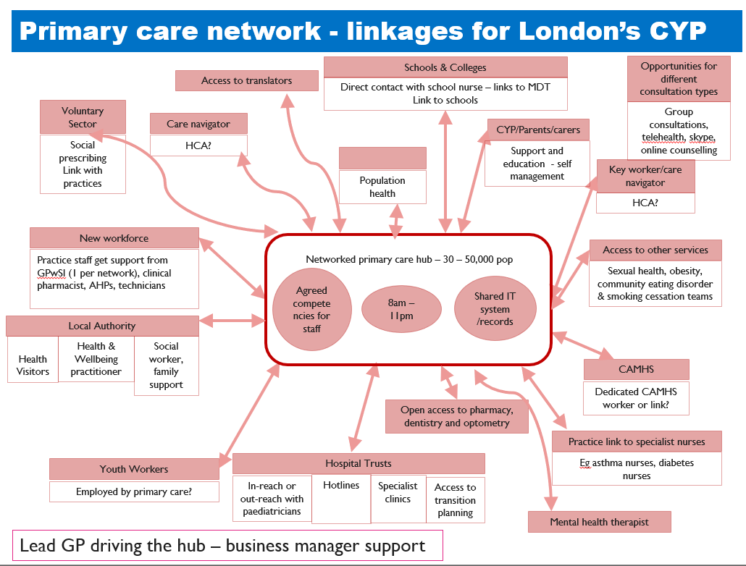

Slide 7
Draft model: primary care network for CYP with asthma

Slide 8
Draft model: primary care network for CYP with mental health conditions
Draft model: primary care network for CYP with mental ill-health

Slide 9
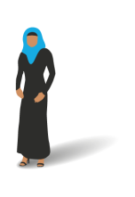
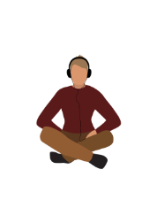
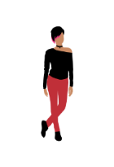
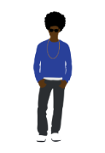
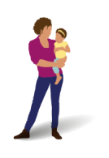
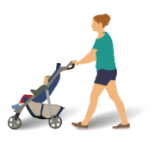
Things I/the network can do to improve care of CYP
TODAY
3 – 6 MONTHS
Phone/email GP/consultant instead of a letter – include e-mail address & telephone number on letter/comms/website profiles
Repository of key contacts on GP wall/ in phone/paeds office
Understand and open up GP availability
Actively promote apps eg NHSGo in every consultation
Work with and promote the connections you have already
Find out who Trust medical directors, PCN directors are and how to work with them
Link potential partner agencies into emerging PCN boards
Bring teaching/learning opportunities into clinical interactions
Find excuses / reasons to visit each others’ workplaces
Start connecting the many people involved in care: start with face to face then reply all cc lists with key professionals
Open up chats about “permission” to behave differently
Use first names wherever possible
Put photo on NHS.net (via web version)
See the next YP I meet alone for part of the consultation
Ask them ‘what matters to you?’ and to bring questions
Access to coaching for GPs
IT – need real time access to data
Patient held records
Put data sharing agreements in place
Upskilling – what can someone else do? Eg receptionists, nurses, HCAs
Contracting with Trusts – paying paediatrician to come into primary care (STP level)
Establish practice and community champions
Work on leadership – pan London, sector, network
Involve CYP in co-production, involve voluntary sector
Workforce: ensure enough capacity/capability to deliver the ask – work sector wide
Establish a lead GP for CYP in each practice
Involve paediatricians in the formation of PCNs
Implement after-school appointments for CYP (cf. Greenwich)
Invite patients/parents/carers to talk at study days
For complex conditions, start seeing CYP at home or school
Primary care network for children and young people
Patch paediatrics: establish a monthly place for education / training /discussion to see professionals face to face, and where families can drop in. Include creche, and have a health visitor available.
Multiple ways to access care eg via youth worker – not just GP as first point of contact
Increase competency & confidence of professionals in PCN – increase specialisms in CYP; learning together
Empower parents around minor illness management and empower young people
Work towards integrated care/primary care/OOH being as trusted as a brand as ED for unplanned care
Change job descriptions & contracts (GPs and consultants)
Develop new roles then training the workforce
MEDIUM TERM
Decommission fax machines
Ex-novate
Don’t use letters – use e-mail – it breaks down barriers. Generic email & phone number for GPs to access specialist care
Don’t send “for info” only “for action”
Don’t tell, teach. Patients want to understand and self-manage
Stop siloed working. Even small steps can help, eg:
Show the patient that we work as a team by name-checking their GP or hospital doctor
Keep the professional team up to date – ask parents who else is involved in their child’s care and who would benefit from a copy of their healthcare report
Involve the voluntary sector: invite local charities in
Get to know other services - arrange a half day exchange with another professional
STOP!

Slide 10
Task and finish group information and membership
The Task & Finish Group (TFG) met three times – in January, March and June 2019.
Its work built on ideas and principles previously developed at a workshop in March 2018 and subsequent round-table discussions as part of a Children and Young People’s event in June 2018. The list below includes those who attended the TFG and/or the preliminary workshop.
Name | Affiliation
Sharafat Ali | West London NHS Trust
Dr Oliver Anglin | North London Health & Care Partners
Keziah Bowers | NHS Islington CCG
Dr Fran Cleugh | Imperial College Healthcare NHS Trust
Dr Virginia Davies | South London & the Maudsley NHS Foundation Trust
Dr Rhiannon England | GP City & Hackney
Dr David Finch (Chair) | Formerly NW London Medical Director (London Region) NHS England
Ronan Fox | NHS Redbridge CCG
Dr Jai Ganapathi | Hillingdon Hospitals NHS Foundation Trust
Barbara Gaskell | Enfield CCG
Diane Hart | Central and NWL NHS Foundation Trust
Dr Jonty Heaversedge | Formerly NHS England
Georgie Herskovits | HLP CYP Programme Manager
Christine Kirkpatrick | HLP CYP Programme Manager
Dr Bob Klaber | Imperial College Healthcare NHS Trust
Name | Affiliation
Rachel Krausz | Northwest London CCGs
Dr Stephanie Lamb | GP Lambeth and Well Centre, Streatham
Dr Eugenia Lee (Chair) | GP Greenwich
Dr Chloe Macaulay | Guy’s and St Thomas NHS Foundation Trust
Suzi McCool | North London Health & Care Partners
Dr Niamh McLaughlin | GP Central London
Rehan Qureshi | Newham CCG
Dr Angelika Razzaque | GP Lewisham CCG
Emma Rigby | Association of Young People’s Health
Sam Rostom | North London Health & Care Partners
Jonathan Sampson | HLP Primary Care Team
Mando Watson | Imperial College Healthcare NHS Trust
Kirsten Watters | Director of Public Health, Southwark
Anne Whately | Central London Community Healthcare NHS Trust
Dr Ingrid Wolfe | Children and Young People’s Health Partnership
Funmi Worrell | HLP Primary Care Programme Manager
Geralyn Wynne | Northwest London STP

Slide 11
More information
Further information can be found on the primary care toolkit
Please contact the programme team with any additional queries:
hlp.cyp-programme@nhs.net

